Slide 1
Preventive Healthcare Measures Post COVID
Kindergarten measure: % of children eligible to enter K on 8/31/2020 meeting K immunization requirements, DOBs: 9/1/2014 – 8/31/2015
MMR measure: % of children eligible to enter K on 8/31/2020 having two doses of MMR immunization, DOBs: 9/1/2014 – 8/31/2015
Seventh grade measure: % of children likely to enter 7th grade on 8/31/2020 meeting 7th grade immunization requirements, DOBs: 9/1/2007 – 8/31/2008
Lead Screening measure: % of children between 12 and 24 months of age as of December 31, 2019 with at least one lead screen, DOBs: 1/1/2018 - 12/31/2018

Slide 2
Preventive Healthcare Measures Post COVID
Run Date | # children in K range | # children meeting K immuni-zation require-ments | % in K range meeting K require-ment | # in K range with 2 MMR | % in K range with 2 MMR | # children in 7th grade DOB range | # meeting 7th grade immuni-zation require-ments | % meeting 7th grade immuni-zation require-ment | # children 12-24 mo on 12/31/19 | # with at least one lead screen | % with at least one lead screen
12/31/2019 | 11813 | 9429 | 79.8% | 10109 | 85.6% | 13424 | 8183 | 61.0% | 11074 | 9028 | 81.5%
7/15/2020 | 11892 | 8729 | 73.4% | 9492 | 79.8% | 12996 | 6375 | 49.1% | 10903 | 7988 | 73.3%
8/1/2020 | 11904 | 8851 | 74.4% | 9594 | 80.6% | 13027 | 6551 | 50.3% | 10903 | 8051 | 73.8%
Source: RIDOH, Center for Health Data and Analysis, KIDSNET
Follow selected age cohorts to track progress
Update 2x per month (1st and 15th)
Compare to similar cohorts in 2019
Data provided to primary care providers at the practice level

Slide 3
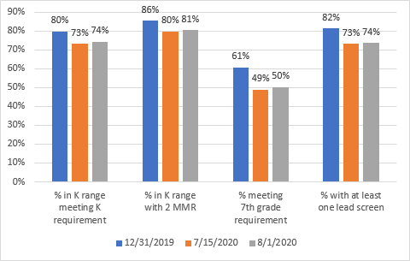
Preventive Healthcare Measures Post COVID
Range among practices with at least 50 patients in the cohort:
K requirements: 44% - 95%
2 MMR: 57% - 94%
7th grade requirements: 9% - 86%
Lead Screening: 35% - 97%

