Slide 2
High-Risk Pediatric Asthma:
Best practices for guidelines-based care
August 21, 2018
Care Transformation Collaborative, PCMH-Kids
Best Practice Sharing Meeting

Slide 3
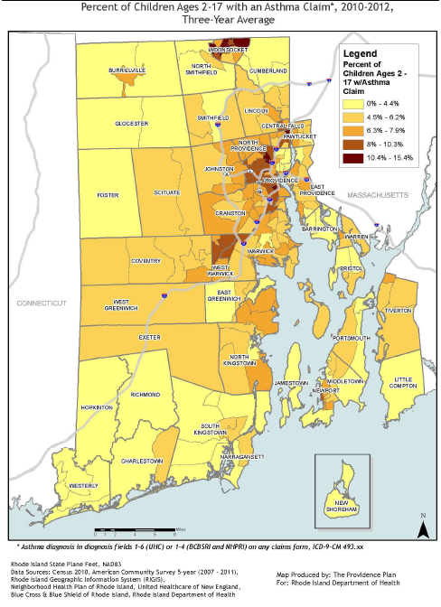
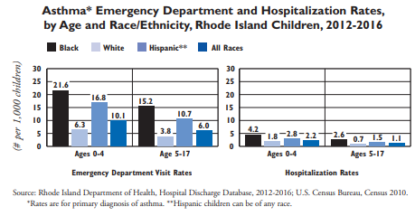
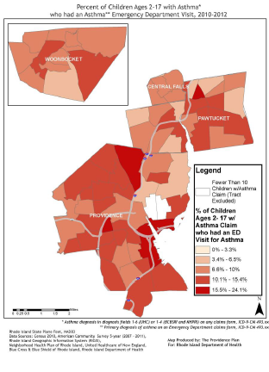
Burden of Asthma in RI

Slide 4
Guidelines-based asthma care
Four core components
Component 1: Assessing and Monitoring Asthma Severity and Asthma Control
Component 2: Asthma Education
Component 3: Environmental Control
Component 4: Pharmacologic Therapy / Medications

Slide 5
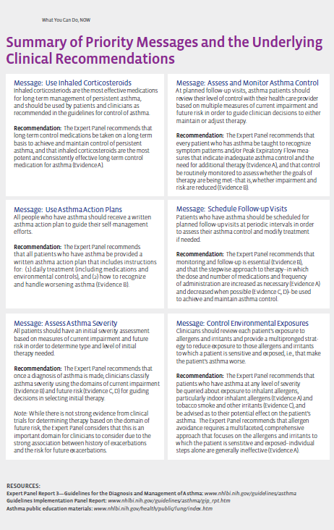
Guidelines-based asthma care

Slide 6
Guidelines-based asthma care
1) Assessing and Monitoring Asthma Severity and Control
Priority action messages:
Assess asthma severity at the initial visit to determine initial treatment.
Assess and monitor asthma control and adjust treatment if needed.
Schedule follow-up visits at periodic intervals.

Slide 7
Guidelines-based asthma care
2) Asthma Education
Recommendation: Every practice serving people with asthma should have a Certified Asthma Educator (AE-C) on staff.
All patients should be provided a written asthma action plan that includes two elements:
1: daily management
2: how to recognize and handle worsening asthma
Asthma Action Plans especially important for patients with moderate or severe persistent asthma, history of severe exacerbations, or poorly controlled asthma

Slide 8
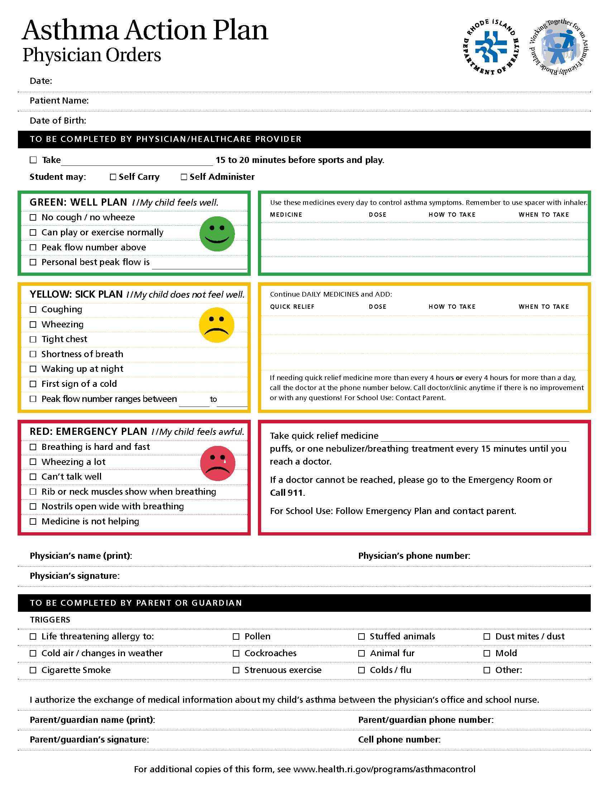
DID YOU KNOW?
Asthma Action Plans are available in KIDSNET
as writeable pdfs that can be uploaded and shared with School Nurse Teachers

Slide 9
Guidelines-based asthma care
3) Control of Environmental Factors
Environmental considerations are both outdoor and indoor, which includes the home environment and school / daycare.
Outdoors
Air pollution
Particulate matter (PM)
Exhaust: Nox, SOx, Ox
Air toxins from industry and transportation
air quality alert days (ozone)
Extreme heat or cold
plant allergens
Indoors
tobacco smoke
burning solid fuels
animal dander
insects (cockroaches, bedbugs)
rodents (rats)
mold and mildew
scented products
cleaners
plant allergens

Slide 10
Environmental Control: Housing
Home Asthma Response Program (HARP)
Education-based home visiting intervention
Medication adherence and compliance
Identification and reduction of home asthma triggers
Patient population: children who have been hospitalized or have had multiple emergency department visits for asthma
Breathe Easy At Home (BEAH)
Healthcare provider referral to city’s housing code enforcement office (currently only four core cities)
Referral completed through KIDSNET
Housing code inspections, corrective action, and legal assistance
Patient population: If medical provider suspects that substandard housing (unaddressed code violations) are major cause of poorly controlled asthma

Slide 11
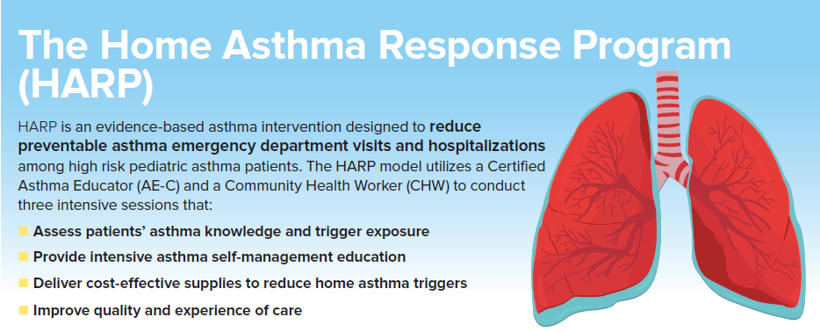
Rhode Island’s Asthma Intervention
Launched in 2011 in collaboration with Hasbro Children’s Hospital, St. Josephs Health Center, HARP is an evidence-based intervention with well-defined and tested partnerships, roles and responsibilities, curriculum, service delivery infrastructure, eligibility criteria, and evaluation framework.

Slide 12
Cost Savings: Reduced Utilization
Combined claims data showed:
Consistent reductions in ER and hospital costs
Higher (% and total) reductions for high utilizer group
Participant results out-performed expected reduction (regression to the mean)

Slide 13
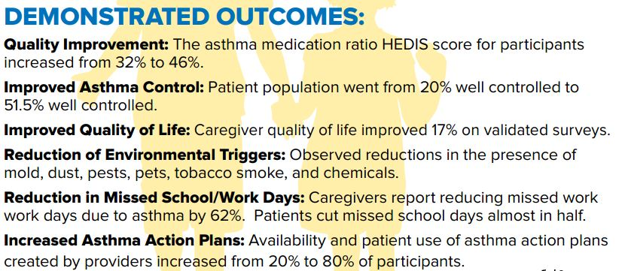
Return on Investment & Outcomes

Slide 14
Asthma Costs in Medicaid
N= 365 6,265 98,725 377 5,888 101,377 345 5,667 102,674
N= 365 6,265 98,725 377 5,888 101,377 345 5,667 102,674

Slide 15
Screening Tool
Screening:
Health Care Use and Asthma Control
If >1 ED visit or inpatient, and/or very poorly controlled symptoms (daily)
2-3 sessions with Certified Asthma Educator (AE-C) and CHW
Environmental Supplies and instruction for remediation
If symptoms > 2x/week but less than daily (i.e. not well controlled)
Single HARP session with AE-C

Slide 16
Referral for HARP
Community Asthma Program at Hasbro
401-444-8340
Miosotis Alsina: MAlsina@Lifespan.org
Telephone screening for eligibility will be determined based on screening for ED/Hospital utilization, asthma control level, geography, and insurance, and patients can be enrolled in the appropriate comprehensive asthma services available.

Slide 17
Julian Drix
Asthma Program Manager
Division of Community Health & Equity
Rhode Island Department of Health
Julian.Drix@health.ri.gov
(401) 222-7742

