Slide 1
Next Steps in Depression Care: and can Psychiatry Help?
Mary Jean Mork, LCSW
April 12, 2018

Slide 2
Objectives
Participants will be able to:
Describe ways to improve depression care for patients in the practices
Identify options for partnering with psychiatry
Identify the key elements of the service and the team members involved
Define next steps to move forward

Slide 3




Maine – where I’m coming from..

Slide 4
Official Disclaimer
Consultant makes no warranty regarding the manner in which any payor, governmental or private, will accept or deny any claim for reimbursement relating to integrated mental health services.
In publishing or otherwise disseminating any Work Product this author makes no representation or warranty regarding the manner in which any payor, governmental or private, will accept or deny any claim for reimbursement relating to integrated mental health services; that the provided is not intended to replace the information contained in the ICD-9-CM and CPT-4 manuals or specific coding, reporting, or reimbursement information that may be disseminated by third-party or government payers; and that providers should seek advice for their own consultants with respect to submission of particular claims or categories of claims for reimbursement by payors.

Slide 5
Why is focus on depression care so important?
Remission of depression and enhanced psychological well-being are the goals of treatment of Major Depressive Disorder
Measuring patients’ symptoms and wellness with rating tools and following evidence-based guidelines can improve outcomes, particularly in patients with severe symptoms
Both pharmacologic and non-pharmacologic treatments (e.g. CBT, exercise) can be effective
No one individual can provide the totality of care needs; a team approach offers patients the best opportunity for symptom recovery and robust wellness
From PCMH Integrated Care: Meet the Behavioral Health Team. W. Clay Jackson, MD, DipTh. Clinical Assistant Professor, Dept. of Family Medicine, Dept. of Psychiatry. University of Tennessee College of Medicine

Slide 6
Why is depression important?
Measuring depression outcomes expected:
  Medicare Shared Savings Program
  Several other quality measurement programs
  CMS measures
Depression
Chronic Medical Conditions
2-3 X Cost of Care
      Economic Impact of Integrated Medical-Behavioral Healthcare, report for American Psychiatric Association, 2014

Slide 7
CMS Measure: MH-1: Depression Remission at Twelve Months
Patients age 18 and older
With major depression or dysthymia and
Have an initial Patient Health Questionnaire (PHQ-9) score greater than nine (PHQ 9 > 9)
Demonstrate remission at twelve months (+/- 30 days after an index visit) defined as a PHQ-9 score less than five (PHQ 9 < 5)
Applies to both patients with newly diagnosed and existing depression whose current PHQ-9 score indicates a need for treatment

Slide 8
CMS Measure: PREV-12: Preventive Care and Screening: Screening for Depression and Follow-Up Plan 2017
Percentage of patients aged 12 years and older
Screened for depression on the date of the encounter using an age appropriate standardized depression screening tool
AND if positive, a follow-up plan is documented on the date of the positive screen

Slide 9
Screening tools
Screening: Completion of a clinical or diagnostic tool used to identify people at risk of developing or having a certain disease or condition, even in the absence of symptoms.
Standardized Depression Screening Tool – A normalized and validated depression screening tool developed for the patient population in which it is being utilized.
Examples of Adolescent Screening Tools (12-17 years)
• Patient Health Questionnaire for Adolescents (PHQ-A)
• Beck Depression Inventory-Primary Care Version (BDI-PC)
• Mood Feeling Questionnaire (MFQ)
• Center for Epidemiologic Studies Depression Scale (CES-D)
• Patient Health Questionnaire (PHQ-9)
• Pediatric Symptom Checklist (PSC-17)
• PRIME MD-PHQ-2

Slide 10
Screening tools - continued
Examples of Adult Screening Tools (18 years and older)
• Patient Health Questionnaire (PHQ-9)
• Beck Depression Inventory (BDI or BDI-II)
• Center for Epidemiologic Studies Depression Scale (CES-D)
• Depression Scale (DEPS)
• Duke Anxiety-Depression Scale (DADS)
• Geriatric Depression Scale (GDS)
• Cornell Scale Screening
• PRIME MD-PHQ-2

Slide 11
Follow-up Plan
Documented follow-up for a positive depression screening must include one or more of the following:
• Additional evaluation for depression
• Suicide Risk Assessment
• Referral to a practitioner who is qualified to diagnose and treat depression
• Pharmacological interventions
• Other interventions or follow-up for the diagnosis or treatment of depression

Slide 12
CMS guidance for PREV-12: Preventive Care and Screening: Screening for Depression and Follow-Up Plan 2017
A depression screen is completed on the date of the encounter using an age appropriate standardized depression screening tool AND if positive, a follow-up plan is documented on the date of the positive screen.
• The name of the age appropriate standardized depression screening tool utilized must be documented in the medical record
• The depression screening must be reviewed and addressed in the office of the provider filing the code, on the date of the encounter
• The screening and encounter must occur on the same date
• Standardized Depression Screening Tools should be normalized and validated for the age appropriate patient population in which they are used and must be documented in the medical record
Follow-Up Plan: The follow-up plan must be related to a positive depression screening, example: “Patient referred for psychiatric evaluation due to positive depression screening.”

Slide 13
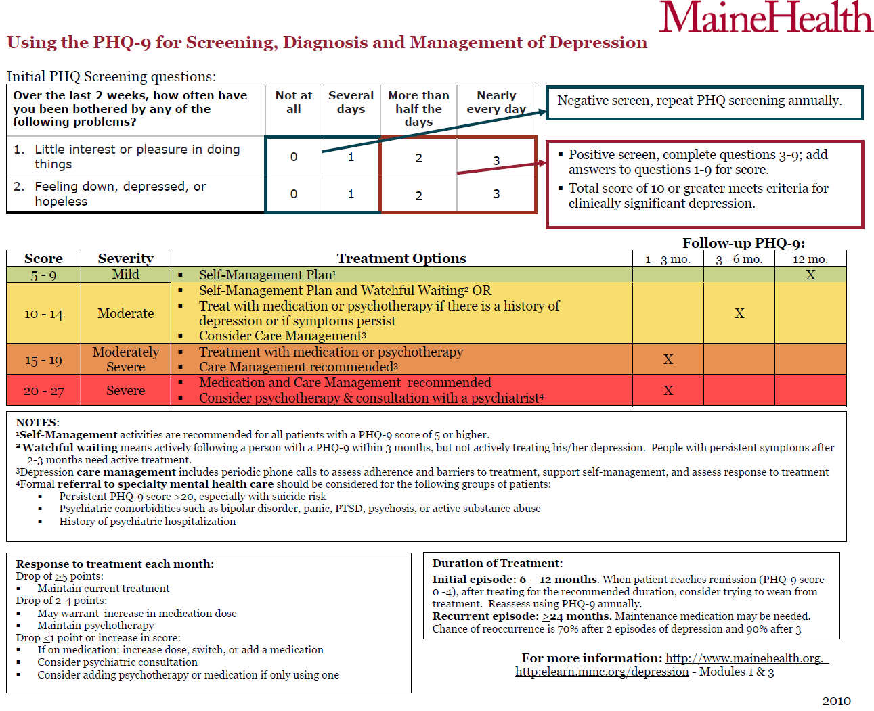

Slide 14
Suicide Risk Assessment – the Columbia Suicide Severity Rating Scale (C-SSRS)
Suicide risk assessment - simple, plain-language questions that anyone can ask
Identifies:
  Risk for suicide
  Severity and immediacy of that risk, and
  Level of support that the person needs.
Users of the C-SSRS tool ask people:
  Whether and when they have thought about suicide (ideation)
  What actions they have taken — and when — to prepare for suicide
  Whether and when they attempted suicide or began a suicide attempt that was either interrupted by another person or stopped of their own volition

Slide 15
C-SSRS - continued
Simple. Ask all the questions in a few moments or minutes — with no mental health training required to ask them.
Efficient. Accurately identifies who needs help and the level of support a person needs,
Effective. Real-world experience and data show the scale has helped prevent suicide.
Evidence-supported. Research has validated the relevance and effectiveness of the questions
Universal. Suitable for all ages and special populations in different settings and is available in more than 100 country-specific languages.
Free.

Slide 16
C-SSRS for Primary Care

Slide 17
Primary & Specialty Medical Health Care
Specialty Mental Health Care
Screening for common mental health conditions
Specialty MH care by referral
Integrated behavioral health services
Primary Care Treatment
Health behavior change/
Stress-related symptoms
Psychiatric consultation
To patients
To providers
Notes:
Behavioral Health integration is not intended to replace specialty mental health but to assist with linkage and access for those patients who need specialty services. One of the primary goals of the BHI/MHI program is to strengthen the link between primary care and specialty mental health.

Slide 18


Creating Psychiatry and Primary Care Partnerships at Any Level
Notes:
Please insert the assigned session number (track letter, period number), i.e., A2a
Please insert the TITLE of your presentation.
List EACH PRESENTER who will ATTEND the CFHA Conference to make this presentation.
You may acknowledge other authors who are not attending the Conference in subsequent slides.

Slide 19
Levels of Integration
 |  | Level | Attributes
Coordinated | Minimal Collaboration | I | Separate site & systems Minimal communication
 | Basic Collaboration at a distance | II | Active referral linkages Some regular communication
Co-Located | Basic Collaboration on site | III | Shared site; separate systems Regular communication
 | Close Collaboration Onsite | IV | Shared site, some shared systems Routine communication and coordination
Integrated | Close Collaborative Approaching Integrated Practice | V | Shared site; shared systems Coordinated treatment plans Regular communication
 | Full Collaboration in a Transformed Integrated Practice | VI | Shared site, vision, systems Shared treatment plans Regular team meetings Population based behavioral health
Adapted from: A Standard Framework for Levels of Integrated Healthcare. National Council for Community Behavioral Healthcare 2013

Slide 20
Levels of Integration for Psychiatry and Primary Care
Level
Attributes
Role of Psychiatry
Primary Care Facility Ramifications
Coordinated
Minimal
I
Separate site &
•
F
ee
-
for
-
service model
None
Collaboration
systems
•
Hand
-
off patients between PCP and
Minimal
Psychiatry
communication
•
Separate record
Basic Collaboration
II
Active referral
•
F
ee
-
for
-
service model
None
at a distance
linkages
•
Hand
-
off patients between PCP and
Some regular
Psychiatry
communication
•
Phone contact to discuss shared patients as
needed.
•
Some coordinated care planning
•
Access to PCP record, but separate records
•
Could allow Collaborative Care model
Co
•
•
-
Located
Basic Collaboration
III
Shared site;
Treat pts in fee
-
for
-
service model
Separate space in facility
on site
separate systems
•
Hand
•
-
off patients between PCP and
Self
-
contained psych space
Regular
Psychiatry
•
Could include group space
communication
•
Phone and in person contact to discuss
shared patients as needed.
•
Some coordinated care planning
•
Access to and communication in PCP record
•
Could allow Collaborative Care model
Close Collaboration
IV
Shared site,
•
Treat pts in
•
fee
-
for
-
service model
Separate space in facility
Onsite
some shared
•
“Share” patients between PCP and
•
Se
lf
-
contained psych space
systems
Psychiatry
•
Shared Consult space in PCP
Routine
•
Phone and in person contact to discuss
area
communication
shared patients.
•
Shared waiting room in PCP
and coordination
•
Coordinated care planning
area
•
•
Access to and communication in PCP record
Access to group room
•
Could allow Collaborative Care model

Slide 21
Integrated
Close Collaborative
V
Shared site;
•
Fee for service within medical practice
•
Space within PCP practice
Approaching
shared systems
•
Shared patients with PCP
•
Same scheduling, wait space,
Integrated Practice
Coordinated
•
In
EMR, medical supports as other
-
person communication
treatment plans
•
Shared care planning
providers
Regular
•
Shared record
•
Access to group room
communication
•
Could allow Collaborative Care model
Full Collaboration
VI
Shared site,
•
Fee for service within medical practice
•
Space within PCP practice
in a Transformed
vision, systems
•
Shared patients with PCP
•
Same scheduling, wait space,
Integrated Practice
Shared treatment
•
In
EMR, medical supports as other
-
person communication
plans
•
Shared care planning
providers
Regular team
•
Shared record
•
Access to group room
meetings
•
Collaborative Care model
Population based
•
Included in med staff meetings
behavioral
health
Adapted from: A
Standard Framework for Levels of Integrated Healthcare. National Council for Community Behavioral Healthcare

Slide 22
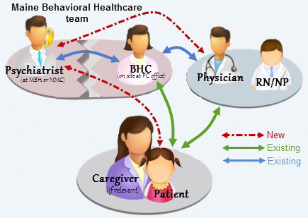
Psychiatry and Primary Care Coordinated care
Telephonic psychiatric consultation to primary care around specific clinical concerns
Education through “lunch and learns”, and informal discussion
Streamlined assess to the psychiatrist re: available community resources
Coordination with integrated behavioral health clinician
Relationship development between primary care and psychiatry = trust

Slide 23
Expected outcomes of better coordination
PCP perception of their ability to deliver behavioral health services:
  Increased confidence in managing behavioral health concerns
  Increased confidence in prescribing psychotropic medications
  Increased knowledge of psychiatric conditions
Mutually developed criteria for transitions to and from specialty care
Number of patients returning to primary care from specialty psychiatry
Access to specialty psychiatry when needed

Slide 24
Shared patient returning to primary care
Development of partnerships
Identification of patients
Established criteria
Process of communication
Joint decision between patient, psychiatrist and primary care
Safety net return to psychiatry as needed
Transition time as needed

Slide 25

Characteristics of a consultation psychiatrist
Flexibility
Openness
Affinity for teaching
Team player
Clinical skills to be effective in brief interventions, establish rapport quickly
Ideal if psychiatrist splits time between mental health clinic and primary care- liaison both ways

Slide 26
At any level – aim for:
Team approach to care
Support for Psychiatry and PCP partnership
Same medical record
Meet at location (either co-located, integrated, tele-video, other?)
Curbside within Epic or other EHR
Consultation and re-consultation
Facilitated referral to Psychiatry ( by BHC)
Ability for patients to flow smoothly between PCP and Psychiatry and back
Support to PCP for difficult patients

Slide 27

Questions and comments – what might work for you?

Slide 28
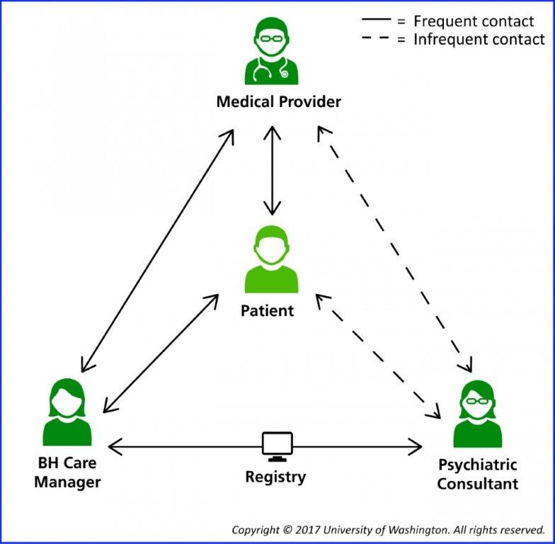
Or you could use….Collaborative Care Codes

Slide 29
Core Principles
Patient Centered Care
Population based care
Measurement based treatment to target
Evidence based care
Accountable Care

Slide 30
Background
CY2016 Medicare Final rule
“Care and management for Medicare beneficiaries with behavioral health conditions may include extensive discussion, information sharing and planning between a primary care physician and a specialist”
CY2017 Medicare Final Rule
CMS proposes separate payment for services under the psychiatric CoCM using three new G-codes:
99492, 99493 and 99494
.

Slide 31
The Collaborative Care Model (CoCM)
Enhances usual medical care by adding care management and psychiatric consultation to the primary care team
Why do it:
  Well established evidence for treating depression
  Better medical outcomes
  Help with patients whose care is challenging
  Faster improvement
  Enhanced care team for population health approach

Slide 32
The Basics
Collaborative care is a team-based service including:
  Treating Medical Practitioner
  Psychiatric Consultant
  Behavioral Health Care Manager

Slide 33
The Basics
Service Components
  Initiating visit with medical provider
  Administration of validated rating scales
  Care planning by the team: may include meds, therapy and/or other treatments
  Behavioral Health care manager follow-up
    Assesses treatment adherence and response
    Uses validated rating scales and brief treatment
  Regular (weekly) case load review with psychiatric consultant

Slide 34

99492 (originally G0502)
Initial Psychiatric Collaborative Care Management
70 minutes in the first calendar month
Outreach to and engagement in treatment of a patient
Initial assessment of the patient using validated rating scales
Development of an individualized treatment plan
  Psychiatric consultant review & modifications

Slide 35

99492
Initial Psychiatric Collaborative Care Management - continued
70 minutes in the first calendar month
Registry for tracking patient follow-up and progress with appropriate documentation
Weekly caseload consultation with the psychiatric consultant
Brief interventions using evidence-based techniques
  Such as behavioral activation, motivational interviewing, and other focused treatment strategies.

Slide 36
99493 (originally G0503)
Subsequent psychiatric collaborative care management
First 60 minutes in a subsequent month of behavioral health care manager activities.
Must include:
Tracking patient follow-up and progress
Weekly caseload review with psychiatric consultant
Coordination with PCP and any other treating provider
Psychiatric consultant review & modifications

Slide 37
99493
Subsequent psychiatric collaborative care management
First 60 minutes in a subsequent month of behavioral health care manager activities.
Must include(continued):
Brief interventions using evidence based treatments
Monitoring of patient outcomes using validated rating scales
Relapse prevention planning
Preparation for discharge from active treatment

Slide 38
99494 (originally G0504)
Additional psychiatric collaborative care management
Each additional 30 minutes in a calendar month of behavioral health care manager activities listed above.
Listed separately and used in conjunction with 99492 and 99493

Slide 39
Blue Cross Blue Shield of Rhode Island policy for “Behavioral Health Integration Services” 2/20/18
https://www.bcbsri.com/sites/default/files/polices/2018%20Behavioral%20Health%20Integration%20Services.pdf
Job description for the behavioral health care manager demonstrating a collaborative integrated relationship with the team - with formalized training or specialized education in behavioral health
Plan for identification, outreach and engagement of patients directed by a primary care provider
Initial assessment, including administration of validated scales and resulting in a treatment plan
Evidence of a compact/contract with a psychiatric consultant
Written workflows documenting:
Psychiatric consultation/referral process
Evidence based treatment interventions to be used
Plans for ongoing collaboration and coordination with PCP and any other treating providers;
Relapse prevention planning and preparation for discharge from active treatment.
Demonstrated use of a registry for tracking patient follow up and progress
Evidence of weekly caseload review with psychiatric consultant
Evidence of monitoring of patient outcomes using validated rating scales

Slide 40
Would this work in your practice?

Slide 41



The Patients
Must be a presenting mental, psychiatric or behavioral health condition that warrants BHI services
Could be either pre-existing or recent diagnosis

Slide 42

Medical Provider
Treating medical practitioner:
  MD, DO, PA, NP, CNS, CNM
  Typically primary care, but may be of another specialty (e.g. cardiology, oncology, psychiatry)
Directs the behavioral health care manager
Oversees the patient’s care, including:
  Prescribing meds,
  Providing treatments for medical conditions, and
  Making referrals to specialty care
Remains involved through ongoing oversight and collaboration

Slide 43

Psychiatrist
Employed by or contracted to the PCP
  Does not necessarily have to be a Medicare provider
Advises regarding:
  Diagnosis
  Recommendations to improve or adjust treatment
  Interactions between behavioral health care and medical care

Slide 44

Psychiatrist - continued
Facilitate referral for direct psychiatric care when indicated
Can deliver face to face service with patient
Consultation can be delivered remotely

Slide 45

Behavioral Health Care Manager
Employed by or contracted to the PCP
Designated member of the care team with
  “formal education or specialized training in behavioral health…but need not be licensed to bill traditional psychotherapy codes”
If independently licensed – can bill for direct services,
  e.g. Assessment and treatment
  Time spent on billable services can’t be counted in CoCM time

Slide 46

Behavioral Health Care Manager
Must:
  Be available to provide services on a face-to-face basis
  Have a continuous relationship with the patients
  Have a collaborative, integrated relationship with the care team
  Be available to engage the patient outside of regular clinic hours as needed

Slide 47

Behavioral Health Care Manager
Services:
  Assesses treatment adherence and clinical response using validated rating scales
  May provide brief evidence-based interventions
  70 minutes of behavioral health care manager time the first month
  60 minutes subsequent months
  Add-on code for 30 additional minutes any month

Slide 48


Effective functions for Behavioral Health Care Manager
  Coordinating treatment
  Providing proactive follow-up of treatment response
  Alerting the PCP when the patient is not improving
  Supporting medication management
  Facilitating communication with the psychiatric consultant
  Offering brief counseling

Slide 49
Codes and Times
Behavioral Health Integration Coding Summary
BHI Code | Behavioral Health Care Manager or Clinical Staff Threshold Time | Assumed Billing Practitioner Time | Payment/Pt (Non-Fac) Primary Care Settings | Payment/Pt (Fac) Hospitals and Facilities
CoCM First Month (99492) | 70 minutes per calendar month | 30 min | $142.84 | $90.08
CoCM Subsequent Months (99493) | 60 minutes per calendar month | 26 min | $126.33 | $81.11
Add-On CoCM (Any month) (99494) | Each additional 30 minutes per calendar month | 13 min | $66.04 | $43.43
General BHI (99484) | At least 20 minutes per calendar month | 15 min | $47.73 | $32.30
BHI Initiating Visit (AWV, IPPE, TCM or other qualifying E/M) | N/A | Usual work for the visit code | Usual | Usual

Slide 50

Billing
Billing is by calendar month
Billing can happen any time during month
  Once minimum time has been spent on collaborative care
Medical provider must see patients not seen within a year of service
  Could be month preceding start of Collaborative Care
  Do not need to see patient during ongoing months of Collaborative Care
Co-pay is required, but could be covered by Medigap plan

Slide 51

Getting Started
Medical provider must see patients not seen within a year of service
  Requires a “comprehensive” E/M visit, annual wellness visit or initial preventive physical exam
  Initial E/M visit billed separately from Collaborative Care
  Must discuss Collaborative Care with patient at that visit

Slide 52
Getting Started
Patient consent is required including:
  Permission to consult with relevant specialist, including psychiatrist
  Cost sharing applied to both in-person and non face-to-face services
  Consent can be verbal but must be documented in record
  New consent needed only if there is a change in medical providers

Slide 53
Initiating Visit
CMS expects an Initiating Visit prior to billing for the 99492-99494 and 99484 codes
Required for new patients and for those who have not been seen within a year of commencement of CoCM or BHI services
Visit includes:
  PCP establishing a relationship with the patient
  Assessing the patient prior to referral
  Obtaining beneficiary consent to consult with specialists

Slide 54
General BHI Code 99484 (previously G0507)
Collaborative Care (CoCM) Codes 99492, 99493, 99494
General BHI Code – 99484

Slide 55
CoCM vs. General BHI code
Collaborative Care Management codes vs. the BHI code
  Can’t be billed on the same month
  Could go back and forth between codes

Slide 56

Implementing the Integrated Care Model -
AIMS Center
Lay the foundation
Plan for the Clinical Practice Change
Build your Clinical Skills
Launch your care
Nurture your Care

Slide 57
Bibliography / Reference – Psychiatry Consultation
Raney, Lori E. Integrated Care: Working at the Interface of Primary Care and Behavioral Health. American Psychiatric Publishing. 2015
Robinson, Patricia J., Reiter, Jeffrey T. Behavioral Consultation and Primary Care: A Guide to Integrating Services. Second Edition. Springer International Publishing. 2016
Martini, Richard, et al. Best Principles of Integration of Child Psychiatry into the Pediatric Health Homes. American Academy of Child and Adolescent Psychiatry. Approved by AACAP Council June 2012. www.aacap.org
Goodrich, David E. et al. Mental Health Collaborative Care and Its Role in Primary Care Settings. US National Library of Medicine. NIH. Curr Psychiatry Rep 2013 Aug 15 (8):383
Raney, Lori E. Integrating Primary Care and Behavioral Health: The Role of the Psychiatrist in the Collaborative Care Model. American Journal of Psychiatry. Vol 172, Issue 8, August 2015
Notes:
Continuing education approval now requires that each presentation include five references within the last 5 years.
Please list at least FIVE (5) references for this presentation that are no older than 5 years.
Without these references, your session may NOT be approved for CE credit.

Slide 58
References for Collaborative Care
https://aims.uw.edu/collaborative-care/implementation-guide The AIMS Center. University of Washington Psychiatry and Behavioral Sciences
Frequently Asked Questions about Billing Medicare for Behavioral Health Integration (BHI) Services. March 9, 2017
CMS CoCM Fact Sheet: https://www.cms.gov/Medicare/Medicare-Fee-for-Service-Payment/PhysicianFeeSched/Downloads/Behavioral-Health-Integration-Fact-Sheet.pdf
https://www.cms.gov/Medicare/Medicare-Fee-for-Service-Payment/PhysicianFeeSched/
Behavioral Health Integration Services. CMS. Medicare Learning Network. ICN 909432 May 2017.

Slide 59

Next Steps for your Practice

Slide 60
Contact
Mary Jean Mork, LCSW
VP for Integrated Programming
Maine Behavioral Healthcare - a member of MaineHealth
morkm@mmc.org
207-662-2490
Presentation offered through the Collaborative Family Healthcare Association
www.cfha.net

