Slide 1
Rhode Island State Innovation Model (SIM)
Leveraging Innovation to Transform Health Systems and Improve Population Health
Integrated Behavioral Health Initiative
Care Transformation Collaborative of Rhode Island

Slide 2
Project Leads: Debra Hurwitz, MBA, BSN, RN Nelly Burdette, PsyD SIM Liaison: James Rajotte, RIDOH Marea Tumber, OHIC Project Start Date: February 2016 Months Implementing: 36 Months Total Budget: $370,000 (SIM) $600,000 (Rhode Island Foundation) $220,000 (Tufts) $1,190,000 Total Budget Formally Evaluated: Yes
Basic Info

Slide 3
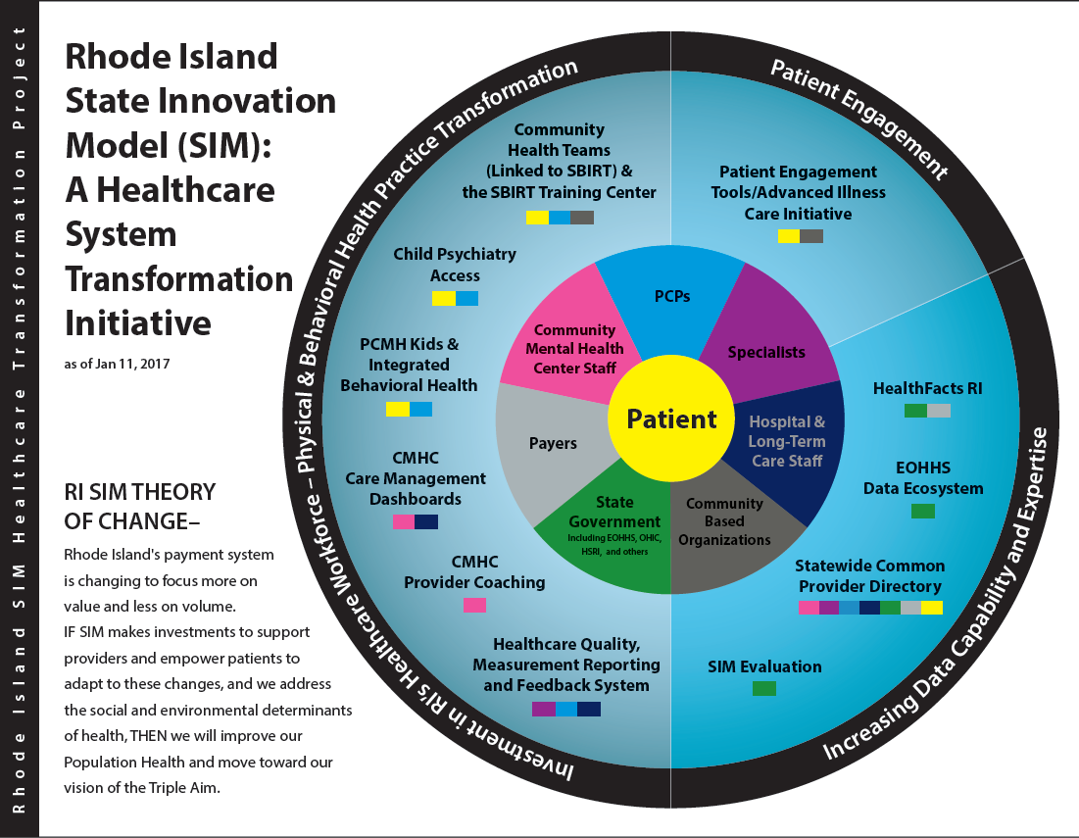
SIM Transformation Wheel
Notes:
What is your role on the SIM wheel?

Slide 4
Background on Project Selection
RI ranks in the top 5 of states for severity based on 13 mental illness indicators
Two-thirds of RI’s mental health clients have at least one serious medical condition
And in the U.S., most patients with mental health needs rely solely on their PCP
Primary care / behavioral health staff have little training in providing integrated behavioral health services in primary care
Unmet Need
How It Works
Onsite IBH Practice Facilitation: support culture change, workflows, billing
Universal Screening: depression, anxiety, substance use disorder
Embedded IBH Clinician : warm hand offs, pre-visit planning, huddles
Three PDSA Cycles : screening, high ED, chronic conditions
Quarterly Best Practice Sharing: data driven improvement, content experts

Slide 5
Project Goals and Audience
Goal 1: Reach higher levels of quality through universal screening
Goal 2: Increase access to brief intervention for patients with moderate depression, anxiety, SUD and co-occurring chronic conditions
Goal 3: Provide care coordination and intervention for patients with high emergency department (ED) utilization /and behavioral health condition
Goal 4: Increase patient self care management skills: chronic condition and behavioral health need
Goal 5: Determine cost savings that primary care can achieve by decreasing ED visits and inpatient hospitalization
Target Audience(s): Ten Patient Centered Medical Home (PCMH) primary care practices serving 42,000 adults
Notes:
Goal 1 : Patients will be healthier based on having better access to screening, brief intervention and care coordination.
The CTC integrated behavioral health model aims to: 1) increase the identification of patients with mental health and substance use disorder (SUD) seen in primary care through universal screening for depression, anxiety and SUD, 2) increase access to brief intervention for patients with moderate depression, anxiety, SUD and co-occurring chronic conditions, 3) improve care coordination for patients with severe mental illness and SUD, 4) provide care coordination and intervention for patients with high emergency department (ED) utilization, 5) test the proposed financial model for long term sustainability with particular attention to ED and in patient (IP) utilization/total cost of care as sustainability measures.
Ten IBH sites represent 42,000 attributed lives.

Slide 6
Results to Date

Slide 7
Results to Date (Continued)
Data Source: Rhode Island All Payer Claims Database
Notes:
Added this slide. Not sure if we’re allowed to add another results slide.

Slide 8
Results to Date (Continued)
Data Source: Rhode Island All Payer Claims Database
Notes:
Added this slide. Not sure if we’re allowed to add another results slide.

Slide 9
Results to Date (Continued)
Data Source: Rhode Island All Payer Claims Database
Notes:
Added this slide. Not sure if we’re allowed to add another results slide.

Slide 10
Lessons Learned
New Unmet or Changing Needs
Copays are a barrier to treatment
Billing and coding difficult to navigate
Workforce Development IBH practice facilitators and IBH clinicians
Things to Do Differently
Give practices 3 to 6 months to prepare for implementation
Billing and coding
Credentialing
EHR modifications
Workflow
Staff training
What Would Be Helpful Post-SIM
Build workforce for Integrated Care
Pilot APM for IBH in primary care
Leverage legislative action; 1 copay in primary care; treat screenings as preventive services
Address needs of small practices through CHT

Slide 11
Question
What other actions would you recommend to support integration of behavioral health in primary care?

Slide 12
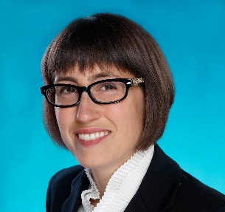
Unexpected Outcomes/Partnerships
Partnered with RI College of Social Work
Placed 15 social work students in primary care
Better Care Through Workforce Development
3 Practice Facilitators specifically trained within IBH in Primary Care
Represents the first training of its’ kind in the country
Interest received from Systems of Care & Dept of Health
Legislative Action: co-pay and credentialing
Wendy Phillips, LMFT
Jennifer Etue, LICSW
Kristin David, PsyD
Notes:
6 months Didactic and Experiential training
Backgrounds include psychology, social work and marriage & family therapy
3 PCMH sites are receiving practice facilitation services over 1-year period

Slide 13
Sustainability Approaches
Funding
SOC: provide primary care practices with infrastructure support to get started
Universal screening coding and billing for reimbursement, all payers.
Turn on health and behavior codes, all payers.
Partnerships
Primary Care practices
RIF/SIM/Tufts
Health plans
OHIC / EOHHS
Higher education
Systems of Care
ACO / AE
Learning
Extend IBH model in pediatrics
Staff Training
Train the Trainer
On line training with hands on support
Ongoing Learning Collaboratives
Present and Publish
Evaluation
Quantitative analysis from Brown University is due Q2 2019.
Ongoing monitoring of TCOC, ED & Inpatient visits using APCD
Supporting Systems of Care in implementation and evaluation

Slide 14
Question
Do you see any partnership opportunities with our project that you hadn’t seen before?

Slide 15
Main Takeaways
Integrated Behavioral Health in Primary Care Works
Improved access, patient care & reduces costs
Onsite practice facilitation by IBH subject matter experts supports culture change for successful implementation
More action is needed
APM for Integrated Behavioral Health in Primary Care
No copays for behavioral health screenings
Eliminate second copay for same day visit
Continue workforce development

Slide 16
Any final questions
or comments?

Slide 17
Contact Information
Debra Hurwitz
dhurwitz@ctc-ri.org
401-519-3921
Project Websites:
www.ctc-ri.org

