Slide 1
Screening for Depression, Anxiety and Substance Use in the Perinatal Period
Margaret Howard, PhD
Professor of Psychiatry & Human Behavior and Medicine, Clinician Educator
Division Director, Women’s Behavioral Health

Slide 2
Funding and Disclosures
Sage Pharmaceuticals Advisory Board
Guidepoint Global Advisors
HRSA UK3MC32244-01-00

Slide 3
Acknowledgements
Rhode Island Dept. of Health
Women & Infants Hospital
Eva Ray, LCSW
Ailis Clyne, MD
Zobeida Diaz, MD
Cynthia Battle, PhD
Jim Beasley, MHA
Jaime Comella, MPH
Monika Drogosz, MPH
Christopher Breault, MA

Slide 4
Why do we care about Women’s Mental Health?
“Depression is the leading cause of lost years of healthy life among women.”
Active maternal mental illness carries risks to the mother, fetus, and infant

Slide 5
Perinatal Depression and Anxiety
COMMON
Prevalence: 15% - 21% (all PMADs)
The most common, unrecognized complication of the perinatal period (compare to 2-5% gestational diabetes)
MORBID
Devastating consequences for women, infants and families:
Poor maternal nutrition
Missed prenatal appointments
Low birth weight
Preterm birth
Small for gestational age
TREATABLE
Byrnes (2019) Arch Psych Nursing
Davalos et al (2012) Arch Women Ment Health 15:1-14
Gavin et al (2005) Obstetrics & Gynecology:
Gaynes et al (2005) AHRQ Systematic Review;
Grigoriadis S et al (2017)Canad Medic Assoc J 189(34)

Slide 6
Perinatal Substance Use
ON THE RISE
Prevalence: up to 10% consume alcohol and 3% binge drink during pregnancy
2% report illicit opioid use
# of women with OUD at labor and delivery quadrupled from 1999 to 2014
MORBID
Impaired decision-making and parenting
Family more likely to become involved with legal and child welfare agencies
Risk of Neonatal Abstinence Syndrome (NAS)
TREATABLE
Ordean et al. (2017) Substance abuse: research and treatment
U.S. Center for Disease Control and Prevention (2018)

Slide 7
Risk Factors
Women with:
Prior history of PPD or MDD
Family History
Depression during Pregnancy*
Intimate Partner Violence
Absence of support
Primary relationship distress
Single parenthood
Current or historical stressful life events (poverty, trauma, death in family)
English et al (2018) Scientific Reports; Lancaster CA et al (2010) et al Am J Ob Gyn,; Koleva et al (2011) Arch Women’s Ment Health; Gavin et al. (2005) Obst & Gyn; Gaynes et al. (2005) AHRQ Systematic Review

Slide 8
Screening: Gaining Traction
Recording of Depression Dx increased 7-fold from 2000-2015 in 27 of 28 states analyzed in women admitted for delivery.
Haight SC et al (2019) Obstet Gynecol 13 (6): 1216-1223.

Slide 9
Screening is Recommended!
)

Slide 10
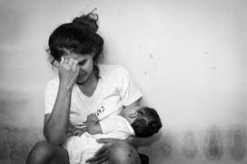
Edinburgh Postnatal Depression Scale (EPDS)
Most commonly used screen for PPD world-wide
10 items and available in 23 languages
Easily administered and scored. Available on the Internet
Validated for use with adolescents
Validated for use with pregnant women
High sensitivity 78%(identified correctly as depressed)
High specificity 99% (identified correctly as non-depressed)
Only stipulation is that Dr. Cox be cited as the author on copies
administered
Moraes et al (2016) Trends Psychiatry Psychother
Longsdon MC et al (2009) Archives of Women’s Ment Health 12: 433-40
Bergink V et al (2011) J Psychosom Res 70: 385-9

Slide 11
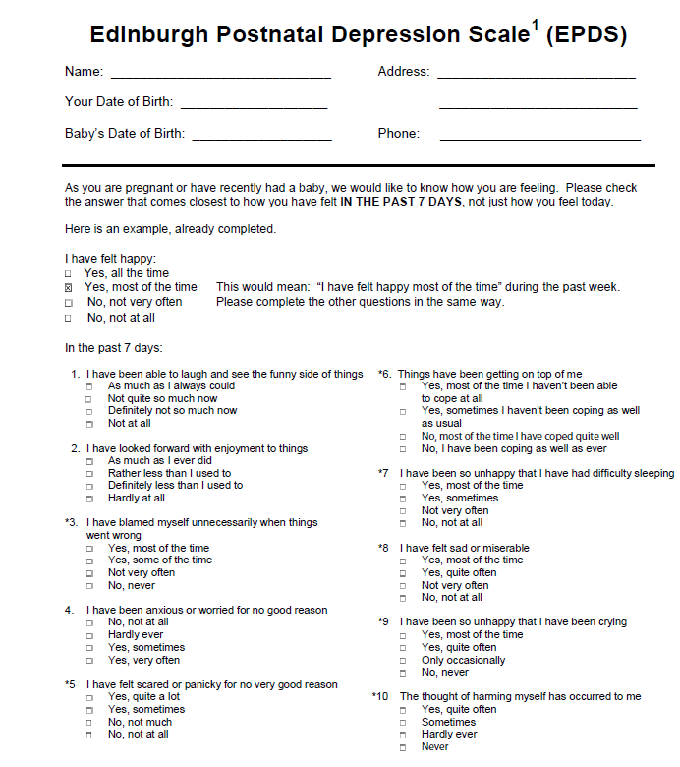

Slide 12
Edinburgh Postnatal Depression Scale (EPDS)
The mother is asked to check the response that comes closest to how she has been feeling in the previous 7 days.
All the items must be completed.
The mother should complete the scale herself without discussing with others, unless she has difficulty with reading
Maximum score: 30
Possibly depressed: 13 or greater
Always look at item 10 (thoughts of self-harm/suicide)
Cox et al (1987). British Journal of Psychiatry 150:782-786

Slide 13
Patient Health Questionnaire-9 (PHQ-9)
Free & available for download at https://www.phqscreeners.com/
Available in 30+ languages
Validated for use with pregnant women
High sensitivity in pregnancy (85%)
High specificity in pregnancy (84%)
Validated for use with adolescents
Easily administered and scored
9 items
Commonly utilized worldwide
Kroenke K, Spitzer RL. Psychiatric Annals 2002;32:509-521.

Slide 14
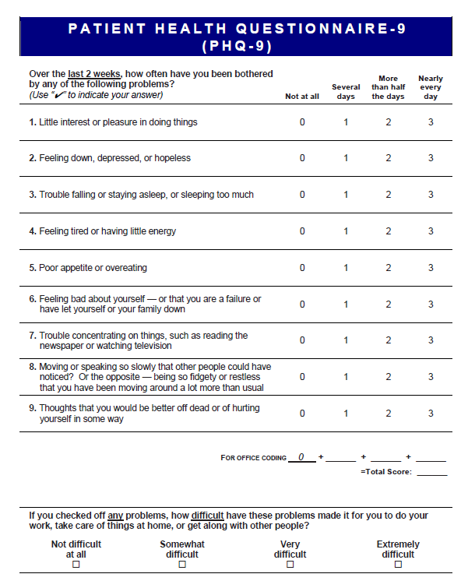

Slide 15
Patient Health Questionnaire-9 (PHQ-9)
The patient is asked to respond to each of the 9 items based on how they’ve been feeling over the last 2 weeks.
The final question asks the patients to report – “How difficult have these problems made it for you to do your work, take care of things at home, or get along with other people?”
not used in calculating score but represents the patient‘s global impression of symptom-related impairment
may be useful in decisions regarding initiation of or adjustments to treatment
Maximum score: 27
Possibly depressed: 10 or greater
Always look at item 9 (thoughts of self-harm/suicide)
Kroenke K, Spitzer RL. Psychiatric Annals 2002;32:509-521.

Slide 16
Generalized Anxiety Disorder – 7 (GAD-7)
Free & available for download at https://www.phqscreeners.com/
Available in 30+ languages
Validated for use with pregnant women
Good sensitivity in pregnancy (73%)
Good specificity in pregnancy (67%)
Easily administered and scored
7 items
Spitzer et al (2006), Arch Intern Med 166:1082-1097
Sinesi et al (2019) BJPsych Open 5(1)

Slide 17
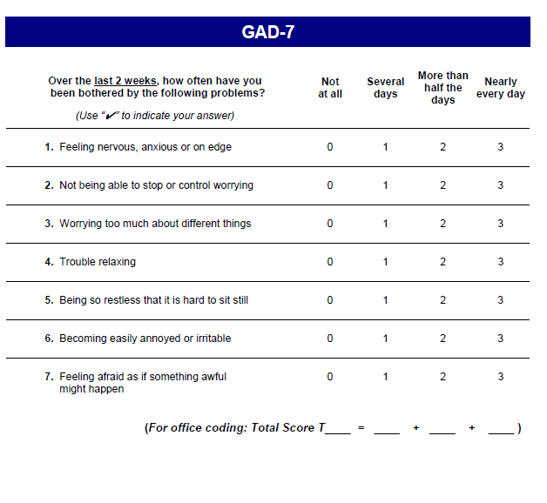

Slide 18
Generalized Anxiety Disorder – 7 (GAD-7)
The patient is asked to respond to each of the 9 items based on how they’ve been feeling over the last 2 weeks.
Designed primarily for Generalized Anxiety Disorder but has moderately good operating characteristics for Panic Disorder, Social Anxiety Disorder and Post-traumatic Stress Disorder
Maximum score: 21
Possible anxiety: 7 or greater
Kroenke K, Spitzer RL. Psychiatric Annals 2002;32:509-521.

Slide 19
Alcohol Use Disorders Identification Test- Concise (AUDIT-C)
Free & available online
Available in English and Spanish
Validated for use in pregnant women
High sensitivity in pregnancy (94%)
High specificity in pregnancy (84%)
Easily administered and scored
3 items
Dawson et al (2005) Alcoholism: Clinical and Experimental Research, 29(5), 844–854.
Bush et al (1998) Arch Internal Med 3: 1789-1795

Slide 20
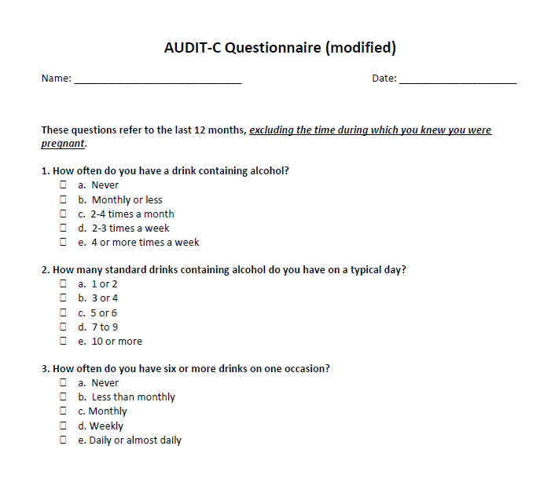

Slide 21
Alcohol Use Disorders Identification Test- Concise (AUDIT-C)
The patient is asked to answer the 3 questions about frequency of alcohol consumption, based on the last 12 months, excluding the time during which they knew they were pregnant.
In perinatal women, a score of 3 or more is considered positive. However, when the points are ALL from Q1 alone (Q2 and Q3 are zero), it can be assumed that the patient is drinking below recommended limits and it is suggested that the provider review the patient’s alcohol intake in the last few months prior to pregnancy to confirm accuracy.
Maximum score: 12
Possible alcohol misuse: 3 or greater
Kroenke K, Spitzer RL. Psychiatric Annals 2002;32:509-521.

Slide 22
Drug Abuse Screening Test-10 (DAST-10)
Free & available online
Available in English and Spanish
Validated for use in pregnant women
High sensitivity in pregnancy (80%)
Good specificity in pregnancy (68%)
Validated for use with adolescents
Easily administered and scored
10 items, Yes/No
Lam et al (2019), Scientific Reports, 5
Yudko et al (2007) Journal of Substance Abuse Treatment. 32(2):189-198.

Slide 24
Drug Abuse Screening Test-10 (DAST-10)
The patient is asked to answer 10 YES/NO questions based on the past 12 months, excluding the time during which they knew they were pregnant
“Drug abuse” refers to the use of prescribed or over-the-counter medications/drugs in excess of the directions AND any non-medical use of drugs
Questions do not include alcohol or tobacco.
Maximum score: 10
Possibly substance misuse: 1 or greater

Slide 25
Screening: What to ask
How are YOU doing?
Are you feeling moodier than normal?
How is your sleep? Can you sleep when the baby sleeps?
Even though everyone expects this to be a happy time, many women who have just had a baby feel sad, nervous, irritable or just “not themselves”. Has this been your experience?
Dawson et al (2005) Alcoholism: Clinical and Experimental Research, 29(5), 844–854.
Bush et al (1998) Arch Internal Med 3: 1789-1795

Slide 26
Screening: What to look for
Tearfulness
Appearing unusually tired
Disheveled, poor hygiene
Poor eye contact
Irritability
Discomfort holding/handling the baby
Significant weight loss
Excessive concern about the baby despite reassurance
Dawson et al (2005) Alcoholism: Clinical and Experimental Research, 29(5), 844–854.
Bush et al (1998) Arch Internal Med 3: 1789-1795

Slide 27
Screening: Assessing Risk of Harm
Suicidal Ideation
HIGHER RISK | LOWER RISK
Hx of Attempts High lethality of past attempts Hx of significant mental illness requiring admissions Current plan/intent Substance abuse Unstable social situation No protective factors | No Hx of Attempts No Hx of significant MH issues No plan No intent No substance use Protective factors (i.e. social connections, spiritual/religious beliefs, meaningful employment)
Thoughts of Harming Baby
HIGHER RISK | LOWER RISK
Poor insight Psychotic symptoms Delusional beliefs with distortion of reality | Thoughts are intrusive and disturbing No psychotic symptoms Thoughts cause fear/anxiety Good insight
Adapted from MCPAP for Moms (2017).
Morriss et al(2013). BMJ: British Medical Journal, 347(7928), 33-35.

Slide 28
Positive Screen
Utilize established clinical protocols
Call 401-430-2800 RI MomsPRN (located at Women’s Behavioral Health - 2 Dudley)
Initiate Treatment
Refer

Slide 29
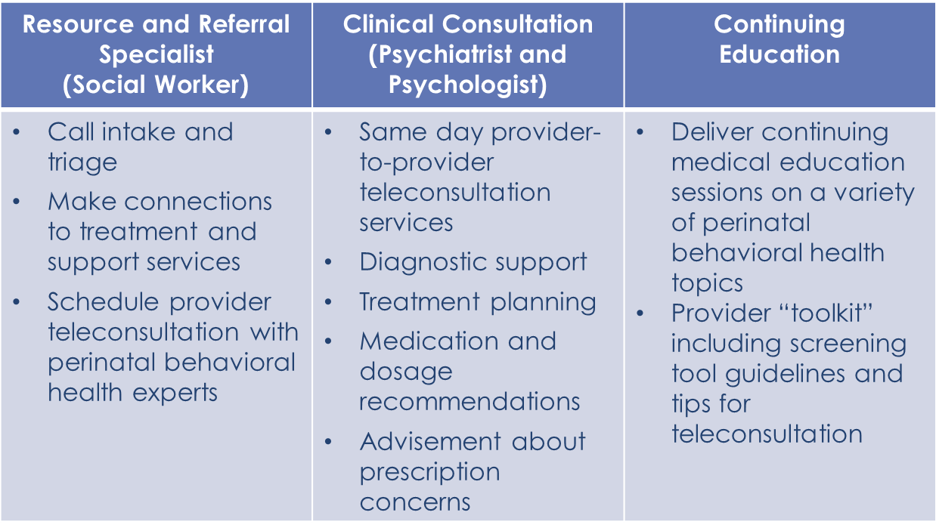
RI MomsPRN Services

Slide 30
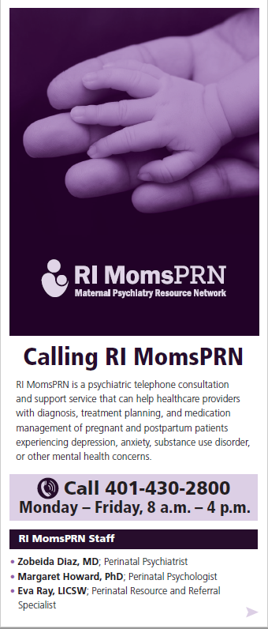
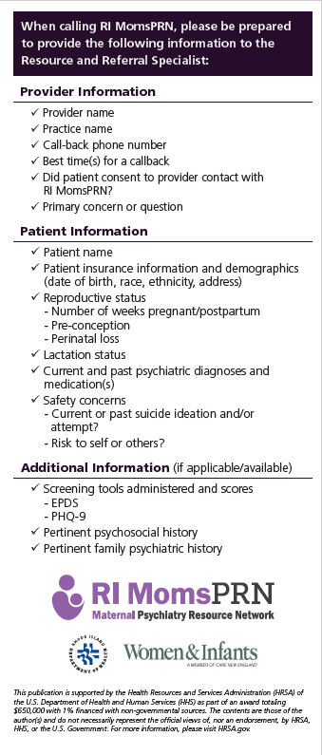

Slide 31
References
Bush K, Kivlahan DR, McDonell MB, et al. The AUDIT Alcohol Consumption Questions (AUDIT-C): An effective brief
screening test for problem drinking. Arch Internal Med. 1998 (3): 1789-1795.
Cox, J.L., Holden, J.M., and Sagovsky, R. 1987. Detection of postnatal depression: Development of the 10-item Edinburgh Postnatal Depression Scale. British Journal of Psychiatry 150:782-786 .
Dawson, D. A., Grant, B. F., Stinson, F. S., & Zhou, Y. (2005). Effectiveness of the Derived Alcohol Use Disorders Identification Test (AUDIT-C) in Screening for Alcohol Use Disorders and Risk Drinking in the US General Population. Alcoholism: Clinical and Experimental Research, 29(5), 844–854.
Kroenke K, Spitzer RL, Williams JBW, Monahan PO, Löwe B. Anxiety disorders in primary care: prevalence, impairment, comorbidity, and detection. Ann Intern Med 2007;146:317-325.
Lam, L. P., Leung, W. C., Ip, P., Chow, C. B., Chan, M. F., Ng, J. W. Y., Chin, R. K. H. (n.d.), (2019). Validation of the Drug Abuse Screening Test (DAST-10): A study on illicit drug use among Chinese pregnant women. Scientific Reports, 5. https://doi-org.revproxy.brown.edu/10.1038/srep11420
Morriss, R., Kapur, N., & Byng, R. (2013). PRACTICE POINTER: Assessing risk of suicide or self harm in adults. BMJ: British Medical Journal, 347(7928), 33-35.
Ordean, A., Graves, L., Chisamore, B., Greaves, L., & Dunlop, A. (2017). Prevalence and Consequences of Perinatal Substance Use-Growing Worldwide Concerns. Substance abuse : research and treatment, 11, 1178221817704692. doi:10.1177/1178221817704692
Sinesi, A., Maxwell, M., O'Carroll, R., & Cheyne, H. (2019). Anxiety scales used in pregnancy: systematic review. BJPsych open, 5(1), e5. doi:10.1192/bjo.2018.75
Spitzer RL, Kroenke K, Williams JBW, Löwe B. A brief measure for assessing generalized anxiety disorder: the GAD-7. Arch Intern Med 2006;166:1092-1097.
Yudko E, Lozhkina O, Fouts A. A comprehensive review of the psychometric properties of the Drug Abuse Screening Test. Journal of Substance Abuse Treatment. 2007;32(2):189-198. doi:10.1016/j.jsat.2006.08.002.

Slide 32
Thank You and Questions
401-430-2800
Mon – Fri, 8a.m.– 4p.m.
MHoward@wihri.org
ERay@wihri.org

