Slide 1
KIDSNET
Seasonal
Flu
Reports

Slide 2
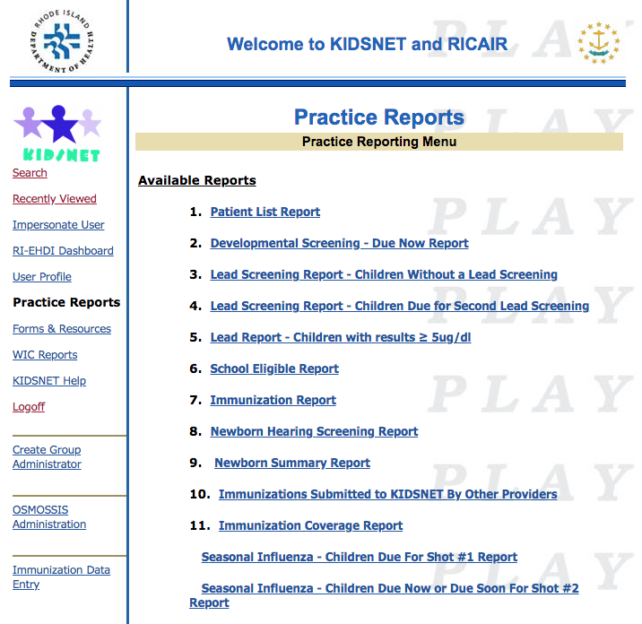
KIDSNET REPORTS

Slide 3
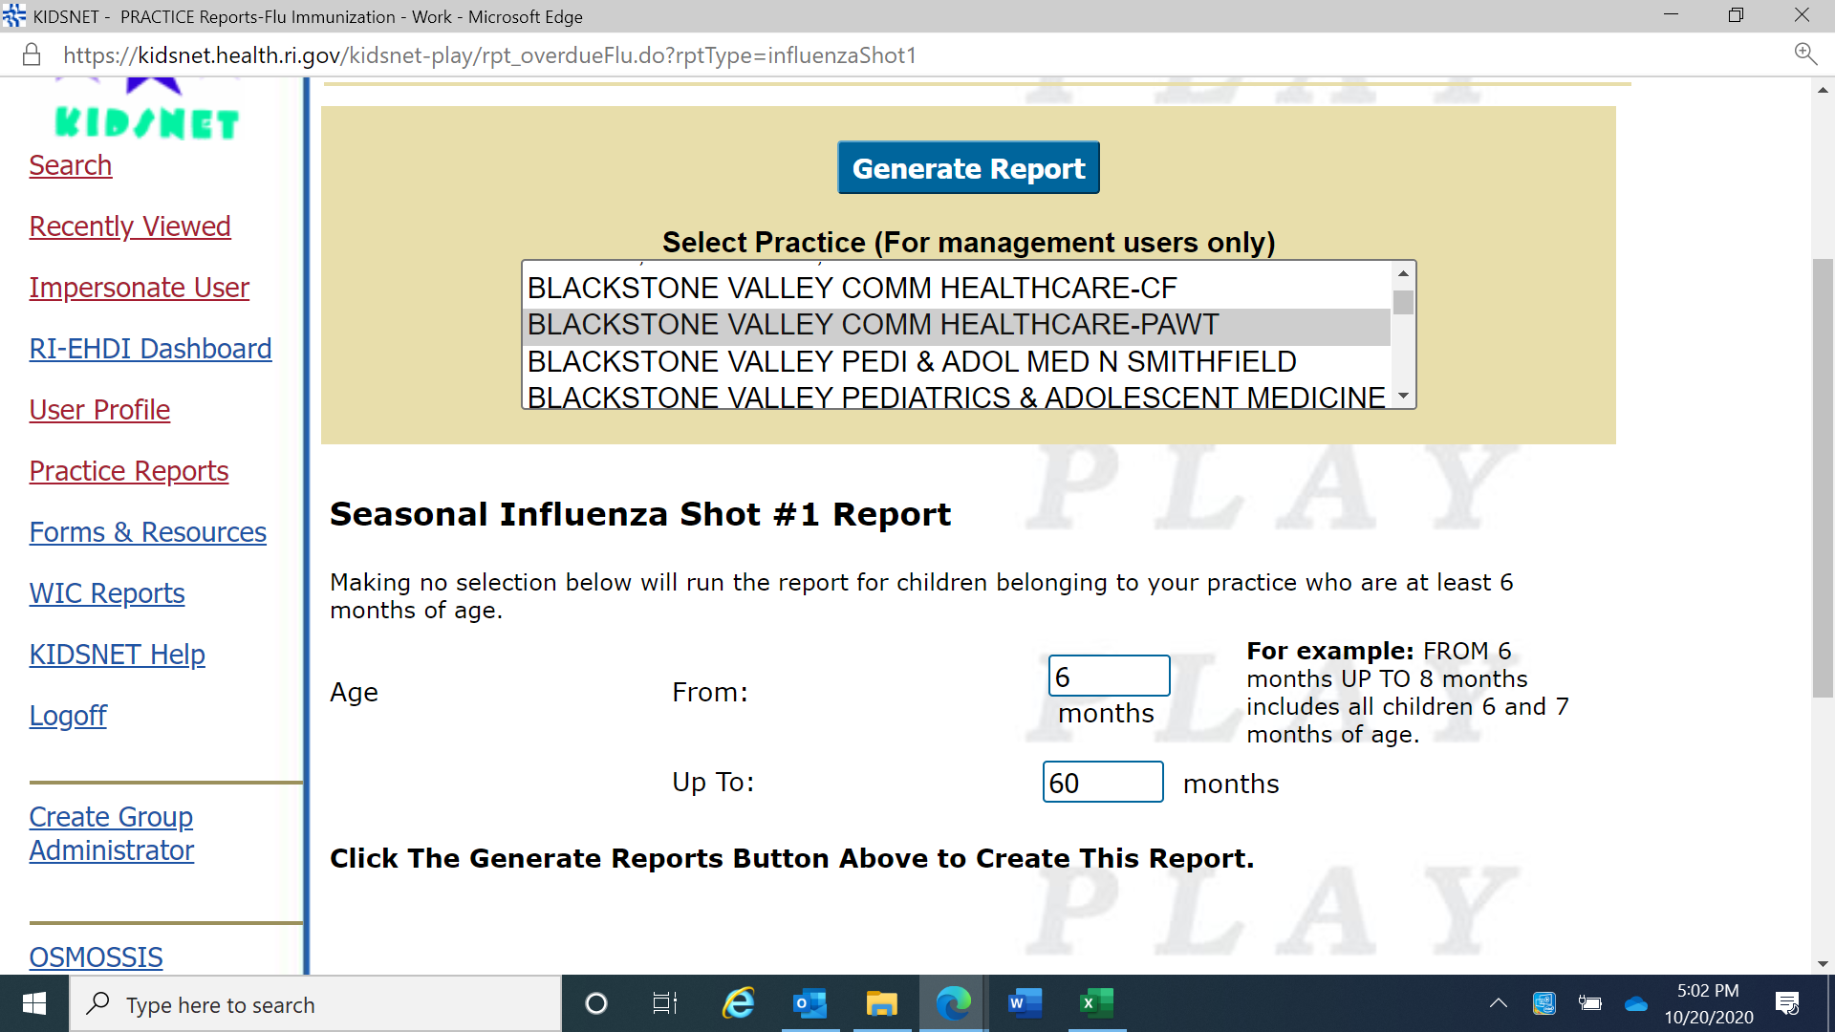
Children Due for Shot # 1
Notes:
An age range may be selected to identify a certain cohort of children by entering the age range in months. The report will soon allow for the report to be run by years as well. To identify the entire practice as a whole, (missing flu) simply select “Generate Report” with no age selection.

Slide 4
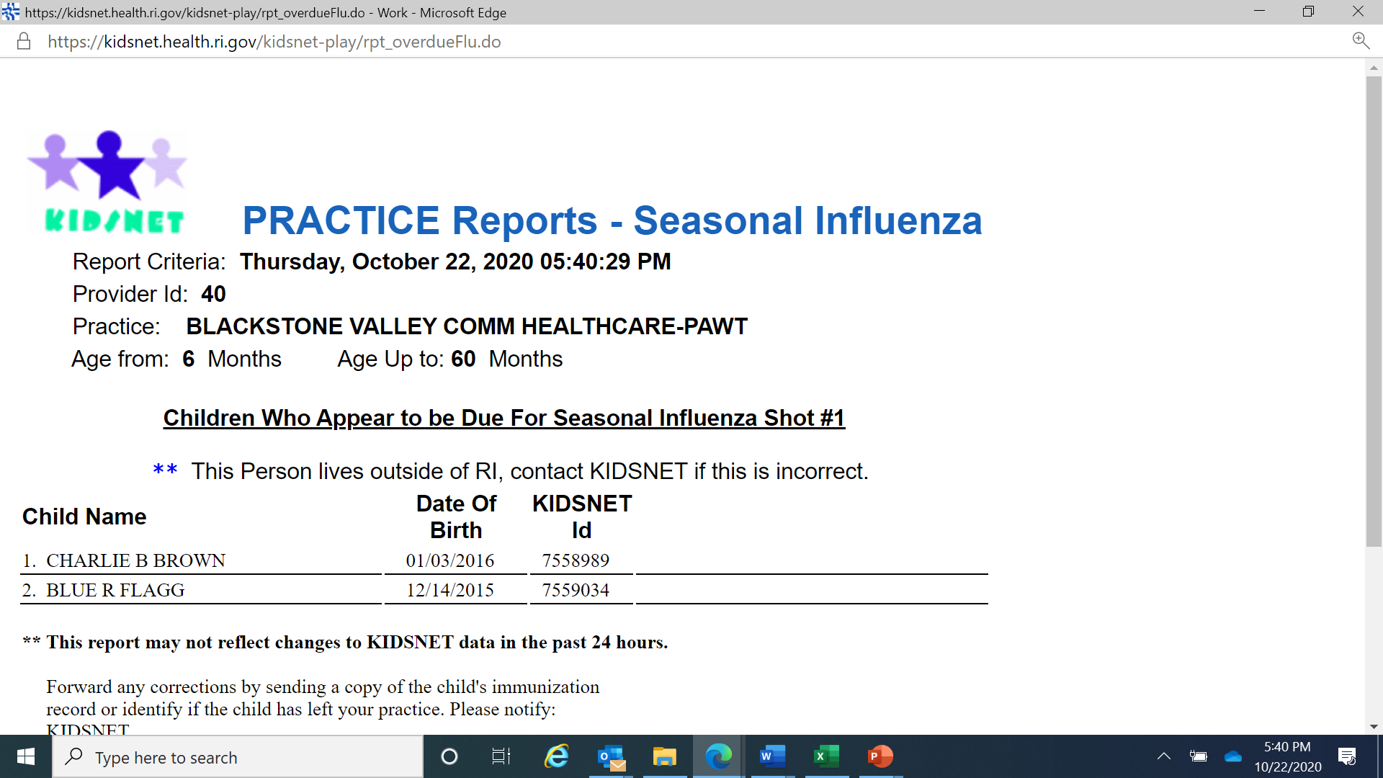
Children Due for Shot # 1

Slide 5
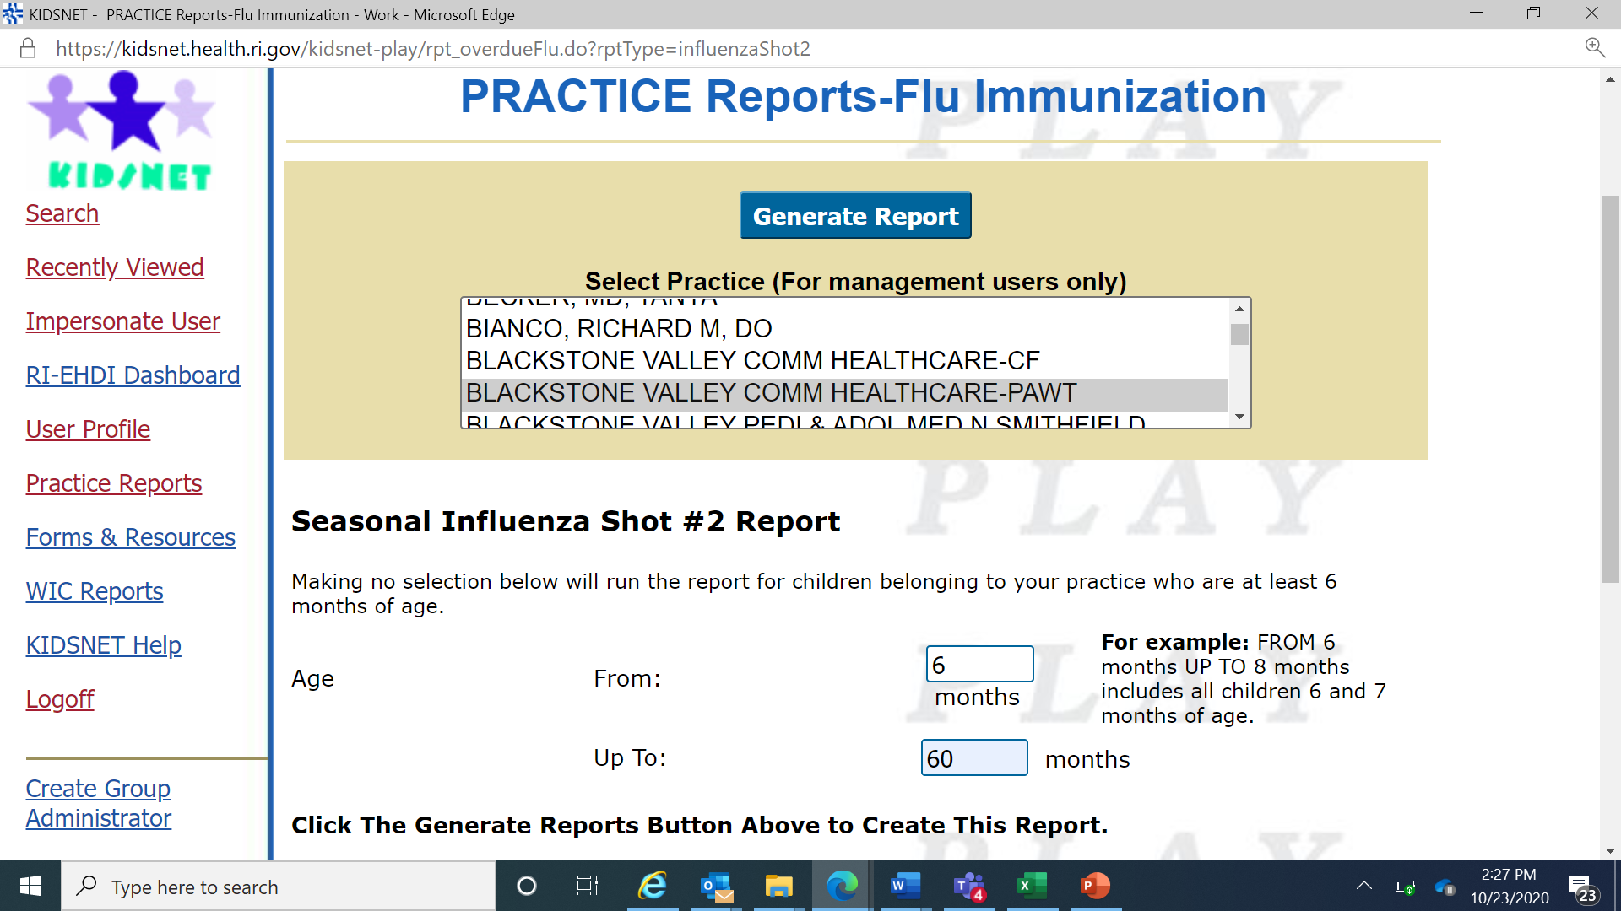
Children Due for Shot # 2
Notes:
Children will need two doses of flu if receiving the vaccine for the first time,

Slide 6
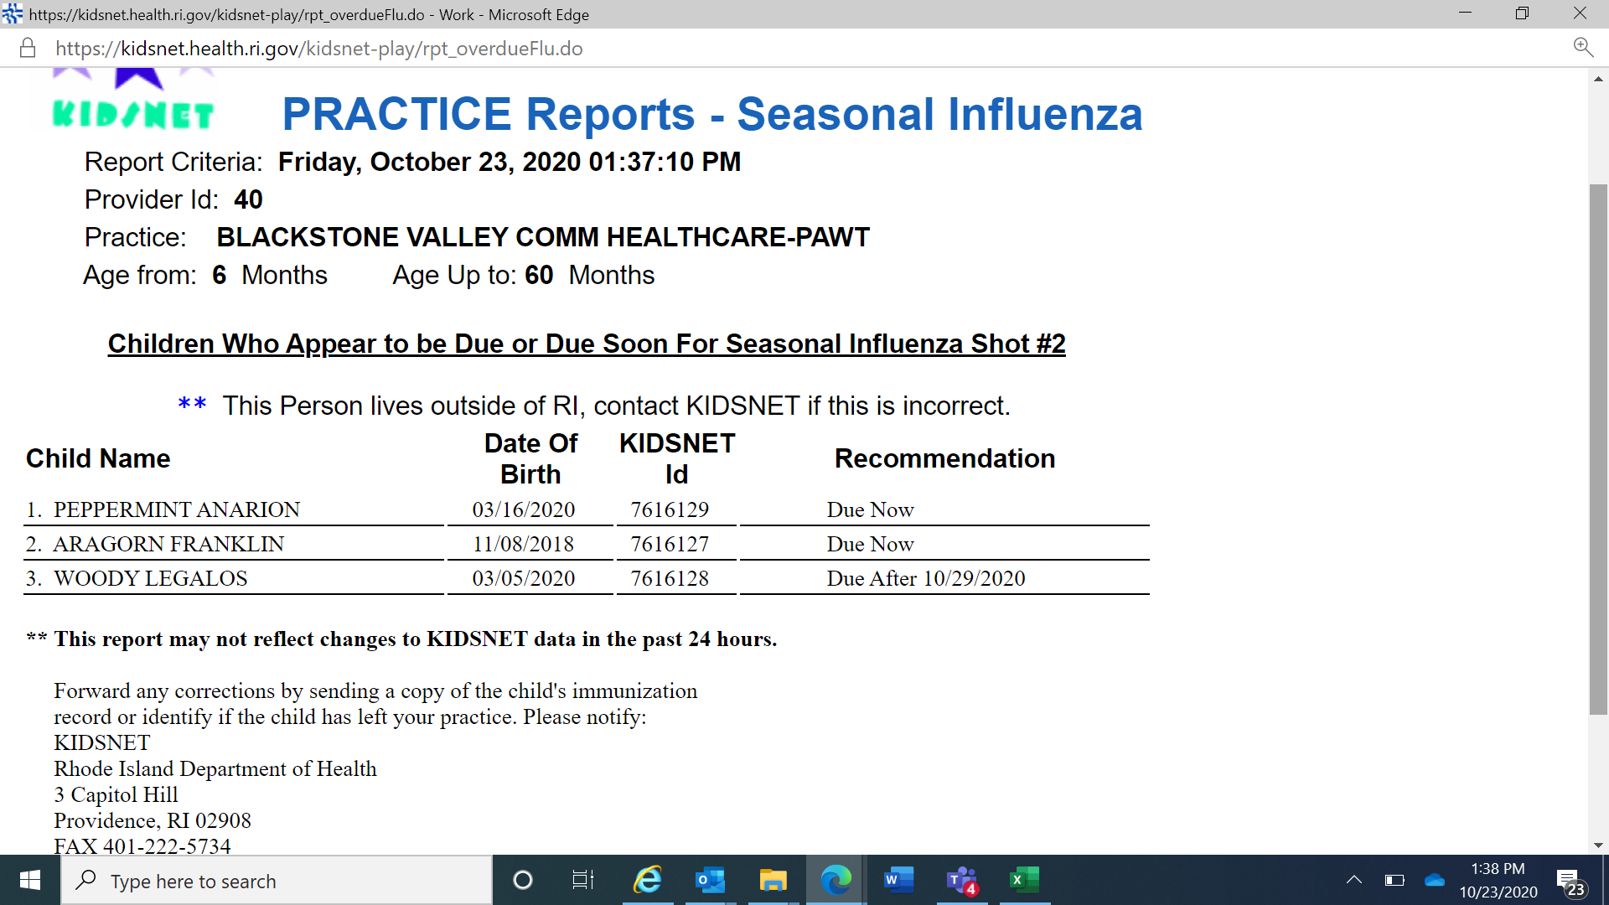
Children Due for Shot # 2

Slide 7
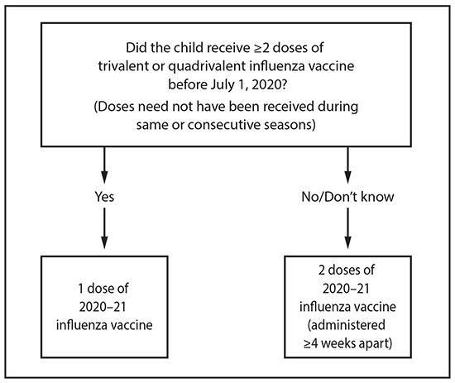
6 Months to 8 Years – 2 Doses?
.
Influenza vaccine dosing algorithm for children aged 6 months through 8 years*
Advisory Committee on Immunization Practices, United States, 2019–20 influenza season.

Slide 8
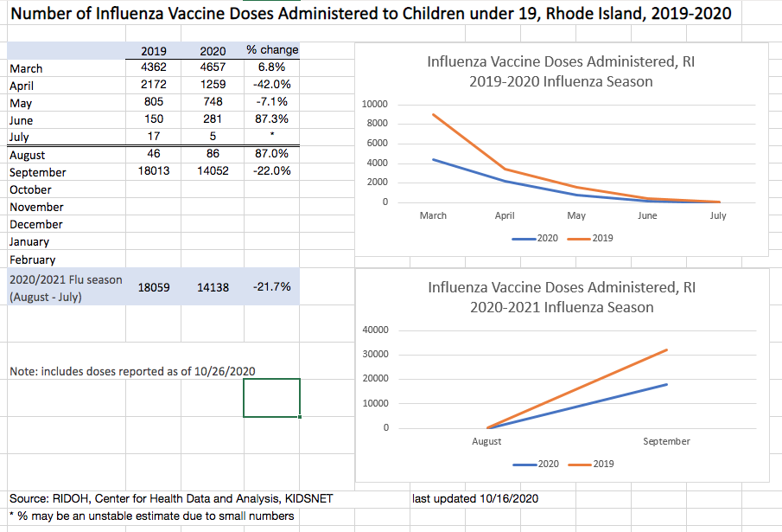
Flu vaccination pre- and post-COVID
Notes:
What information is available on each child?

Slide 9
Janet Limoges
KIDSNET Provider Relations Manager
401.222.7681
Janet.limoges@health.ri.gov
www.health.ri.gov
Notes:
What information is available on each child?

