Slide 1










Welcome
Practices
Cohort 3
Full Circle Health &
RI Women’s Health and Midwifery
Division of Maternal-Fetal Medicine

Slide 2

Agenda
Topic Presenter(s) | Duration
Welcome Remarks Deborah Garneau, RIDOH | 5 minutes
CTC and Practice Introductions All | 20 minutes
Woman and Infants Teleconsultation Overview and Screening Presentation Margaret Howard, WIH | 30 minutes
Question and Answer Period All | 15 minutes
CTC Milestone Review Susanne Campbell, CTC | 10 minutes
Measurement Evaluation Discussion Jim Beasley, RIDOH | 10 minutes

Slide 3


Statewide initiative modeled after PediPRN & funded by HRSA
Focused on practices/providers seeing pregnant/postpartum patients
The goal is to help providers screen and address perinatal depression, anxiety, and/or substance use by offering access to
  perinatal behavioral health teleconsultation line (WIH) and
  virtual practice advisement and support services (CTC-RI)

Slide 4

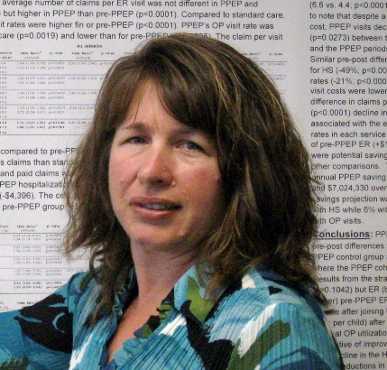









RIDOH Team and Supports
Deb Garneau, MA Jennifer Levy, MD Jordan White, MD Jim Beasley, MPA
MCH/Project Director Consultant Medical Director Consultant Medical Director Program Manager
Evaluation and programmatic assistance
Maternal and child health policy and clinical expertise
Connections to statewide maternal/child health clinical programs/iniatives
RI Task Force to Support Pregnant and Parenting Families with Substance-Exposed Newborns
RIDOH Title X Family Planning Supports & RIghtTime app

Slide 5

Overview of CTC
Care Transformation Collaborative of R.I.
[Ri momsprn cohort 3 kick-off]
[June 28 2022]
Sign up for our newsletters: Monthly Newsletters | CTC-RI (ctc-ri.org)
Our Website: ctc-ri.org

Slide 6

What is CTC?
CTC works with key stakeholders who select, test and evaluate innovative clinical strategies to build the capacity of the RI primary care team to meet the needs of families living in our communities – intended to result in better care, smarter spending and informed public policy
Growing impact across RI:
  About 695,000 Rhode Islanders receive care from one of our practices
  About 800 providers across our adult and pediatric practices
  Worked with 58 providers at 4 pre-natal practices in the RI MomsPRN Program, Cohort 1
  Worked with 96 providers at 9 pre-natal practices in the RI MomsPRN Program, Cohort 2

Slide 7




CTC Team
Oversight of QI Activities:
  Susanne Campbell, RN, MS, PCMH CCE
    Senior Project Director
  Pano Yeracaris, MD, MPH
    Chief Clinical Strategist
Evaluation & Program Coordination:
  Carolyn Karner, MBA
    Program Coordinator and Data Analyst
  Jade Arruda, BS
    Program Administrator

Slide 8



CTC Practice Facilitators
Kim Nguyen-Leite, MHA
  PF: Full Circle Health,
  RI Women’s Health and Midwifery
Suzanne Herzberg, PhD, MS, OTR/L
  PF: BVCHC, RIHB & Hope Family Health,
  Tri-County, VICTA, CCAP
Jody Vieira, LICSW
  PF: WIH MFM, Direct Doctors

Slide 9
Returning Practices
1. Blackstone Valley Community Health Care - Pawtucket | Kelsey Okolowitcz
2. RI Home Birth & Hope Family Health - Hope | Mary Schwartz Mumford
3. Tri-County Community Action Agency - Johnston | Jennifer Caffrey
4. VICTA - Providence | Lisa Peterson
5. W&I Maternal Fetal Medicine - Providence | Martha Kole-White
New Practices
1. Comprehensive Community Action Program - Cranston | Jessica Anderson
2. Direct Doctors - East Greenwich | Ashley Lakin
3. Full Circle Health - Woonsocket | Adam Hermance
4. RI Women’s Health and Midwifery - Woonsocket | Adam Hermance
What does your practice hope to get out of the RI MomsPRN Program?

Slide 10
Past Cohort Achievements

Slide 11
Screening for Depression, Anxiety and Substance Use in the Perinatal Period
Margaret Howard, Ph.D.
Division Director, Women’s Behavioral Health, Women & Infants Hospital
Executive Director, Women’s Behavioral Health
CTC Cohort 3
Learning Collaborative Kickoff
June 28, 2022

Slide 12
Funding and Disclosures
Sage Therapeutics Advisory Board
HRSA UK3MC32244-01-00

Slide 13

Acknowledgements
Rhode Island Dept. of Health
Women & Infants Hospital
Zobeida Diaz, MD
Anupriya Gogne, MD
Cynthia Battle, PhD
Eva Ray, LCSW
Erica Oliveira, BA
Jordan White, MD
Jennifer Levy, MD
Deb Garneau, MA
Jim Beasley, MPA
Monika Drogosz, MPH
Christopher Breault, MA
Tuesday June 28, 2022

Slide 14
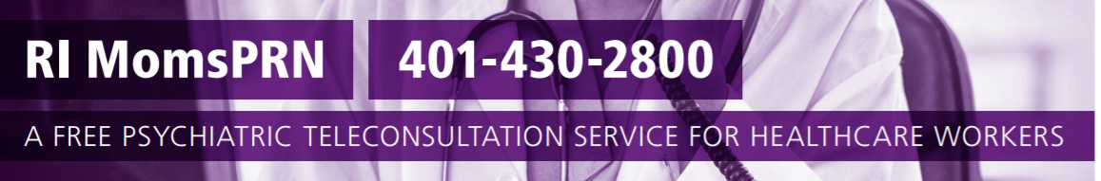


Goal is to empower healthcare providers who treat pregnant/postpartum women to universally screen and respond to the behavioral health/substance use needs of their patients
Free statewide teleconsultation service offering clinical consultation and guidance on diagnosis, treatment planning, and/or referrals to community-based treatment and support services
Margaret Howard, PhD
Zobeida “Zee’ Diaz, MD
Anupriya Gogne, MD
Cynthia Battle, PhD
Eva Ray, LICSW
Erica Oliveira, BA

Slide 15

Why do we care about
Women’s Mental Health?
“Depression is the leading cause of lost years of healthy life among women.”
Active maternal mental illness carries risks to the mother, fetus, and infant

Slide 16

Perinatal Depression and Anxiety
COMMON
  Prevalence: 15% - 21% (all PMADs)
  The most common, unrecognized complication of the perinatal period
MORBID
  Devastating consequences for women, infants and families:
    Poor maternal nutrition
    Missed prenatal appointments
    Low birth weight
    Preterm birth
TREATABLE
Byrnes (2019) Arch Psych Nursing
Davalos et al (2012) Arch Women Ment Health 15:1-14
Gavin et al (2005) Obstetrics & Gynecology:
Gaynes et al (2005) AHRQ Systematic Review;
Grigoriadis S et al (2017)Canad Medic Assoc J 189(34)

Slide 17



Risk Factors
Women with:
  Prior history of PPD or MDD
  Family History
  Depression during Pregnancy*
  Intimate Partner Violence
  Absence of support
  Primary relationship distress
  Single parenthood
  Current or historical stressful life events (poverty, trauma, death in family)
  Young Age
  Pregnancy or delivery complications
English et al (2018) Scientific Reports; Lancaster CA
Ghaedrahmati, M., et al. (2017) Journal of Education and Health Promotion
Koleva et al (2011) Arch Women’s Ment Health
Gavin et al. (2005) Obst & Gy
Gaynes et al. (2005) AHRQ Systematic Review

Slide 18
Perinatal Substance Use
ON THE RISE
  Prevalence: up to 10% consume alcohol and 3% binge drink during pregnancy
  2% report illicit opioid use
  # of women with OUD at labor and delivery quadrupled from 1999 to 2014
MORBID
  Impaired decision-making and parenting
  Family more likely to become involved with legal and child welfare agencies
  Risk of NAS/NOWS (Neonatal Abstinence Syndrome; Neonatal Opioid Withdrawal Syndrome)
TREATABLE
  Pregnancy is often (not always) a uniquely powerful motivator for sobriety
Ordean et al. (2017) Substance abuse: research and treatment
U.S. Center for Disease Control and Prevention (2018)

Slide 19

Screening: Gaining Traction
Over a 15-year period, there’s been a significant increase (7x) in screening for depression in obstetrical settings
Haight SC et al (2019) Obstet Gynecol 13 (6): 1216-1223.

Slide 20





Screening is Recommended!
)

Slide 21
Edinburgh Postnatal Depression Scale (EPDS)
The mother is asked to check the response that comes closest to how she has been feeling in the previous 7 days.
All the items must be completed.
The mother should complete the scale herself without discussing with others, unless she has difficulty with reading
Maximum score: 30
Possibly depressed: 13 or greater
Always look at item 10 (thoughts of self-harm/suicide)
Cox et al (1987). British Journal of Psychiatry 150:782-786

Slide 22
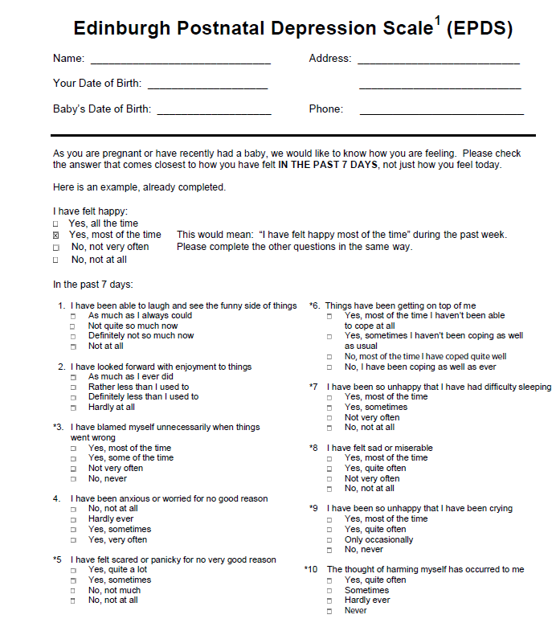

Slide 23
Patient Health Questionnaire-9 (PHQ-9)
The patient is asked to respond to each of the 9 items based on how they’ve been feeling over the last 2 weeks.
An additional question asks the patients to report – “How difficult have these problems made it for you to do your work, take care of things at home, or get along with other people?”
  not used in calculating score but represents the patient‘s global impression of symptom-related impairment
  may be useful in decisions regarding initiation of or adjustments to treatment
Maximum score: 27
Possibly depressed: 10 or greater
Always look at item 9 (thoughts of self-harm/suicide)
Kroenke K, Spitzer RL. Psychiatric Annals 2002;32:509-521.

Slide 24
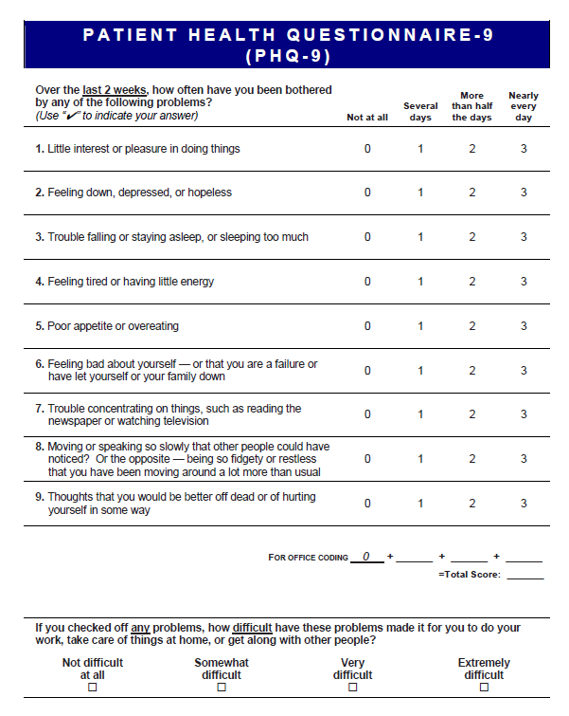

Slide 25

Generalized Anxiety Disorder – 7 (GAD-7)
The patient is asked to respond to each of the 9 items based on how they’ve been feeling over the last 2 weeks.
Designed primarily for Generalized Anxiety Disorder but can also indicate possible Panic Disorder, Social Anxiety Disorder or Post-traumatic Stress Disorder
Maximum score: 21
Possible anxiety: 7 or greater
Kroenke K, Spitzer RL. Psychiatric Annals 2002;32:509-521.

Slide 26
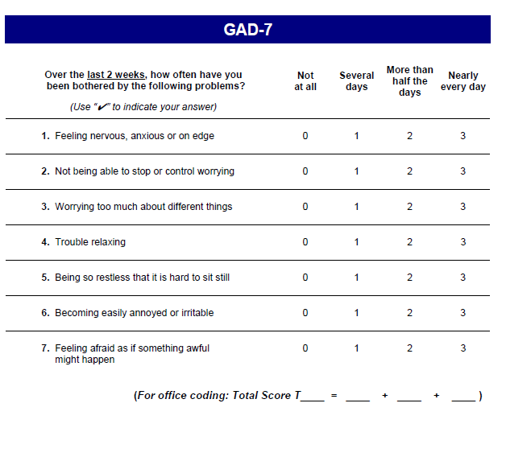

Slide 27
NIDA Quick Screen
The patient is asked to respond to one question over 4 domains in past year
No numerical score
Any answer other than “never” is a positive screen and should prompt follow-up questions to further about which substance(s) are being used, the amount, and the time course
Smith PC, Schmidt SM, Allensworth-Davies D, Saitz R. A single-question screening test for drug use in primary care. Archives of internal medicine. Jul 12 2010;170(13):1155- 1160.

Slide 28
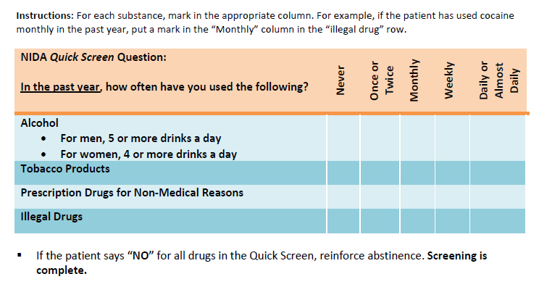

Slide 29

Screening: What to ask
  How are YOU doing?
  Are you feeling moodier than normal?
  How is your sleep? Can you sleep when the baby sleeps?
  How is your appetite?
  Even though everyone expects this to be a happy time, many women who have just had a baby feel sad, nervous, irritable or just “not themselves”. Has this been your experience?

Slide 30

Screening: What to look for
Tearfulness
Appearing unusually tired
Disheveled, poor hygiene
Poor eye contact
Irritability
Discomfort holding/handling the baby
Significant weight loss
Excessive concern about the baby despite reassurance

Slide 31

Positive Screen – What now?
Utilize established clinical protocols
Call RI MomsPRN: 401-430-2800
Initiate Treatment with RI MomsPRN consultation
Refer for ongoing BH treatment

Slide 32
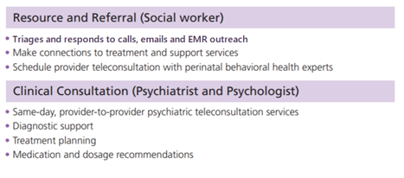

Providers are welcome to consult with a perinatal psychiatrist or resource referral specialist via telephone, secure email, or EMR engagement

Slide 33

Lessons Learned
Returning Practices…
  What do you wish you knew before joining the collaborative in Cohort 2?
  Any tips or insights to share with new practices in Cohort 3?
Division of Maternal-Fetal Medicine

Slide 34

Thank you!
Questions are Welcome
Call
401-430-2800
Monday – Friday, 8AM – 4PM
EMAIL
RIMomsPRN@CARENE.oRG
ERAY@WIHRI.ORG

Slide 35

Milestone Review
Susanne Campbell, ctc

Slide 36
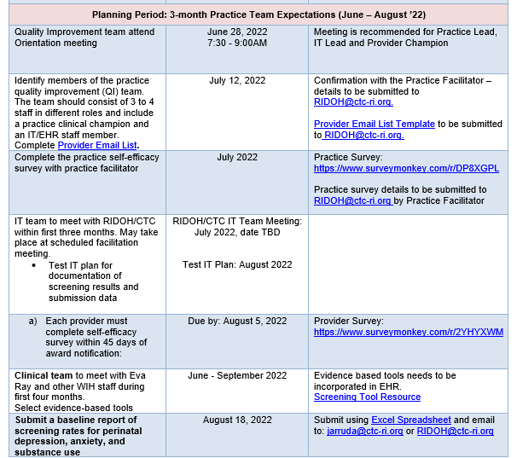
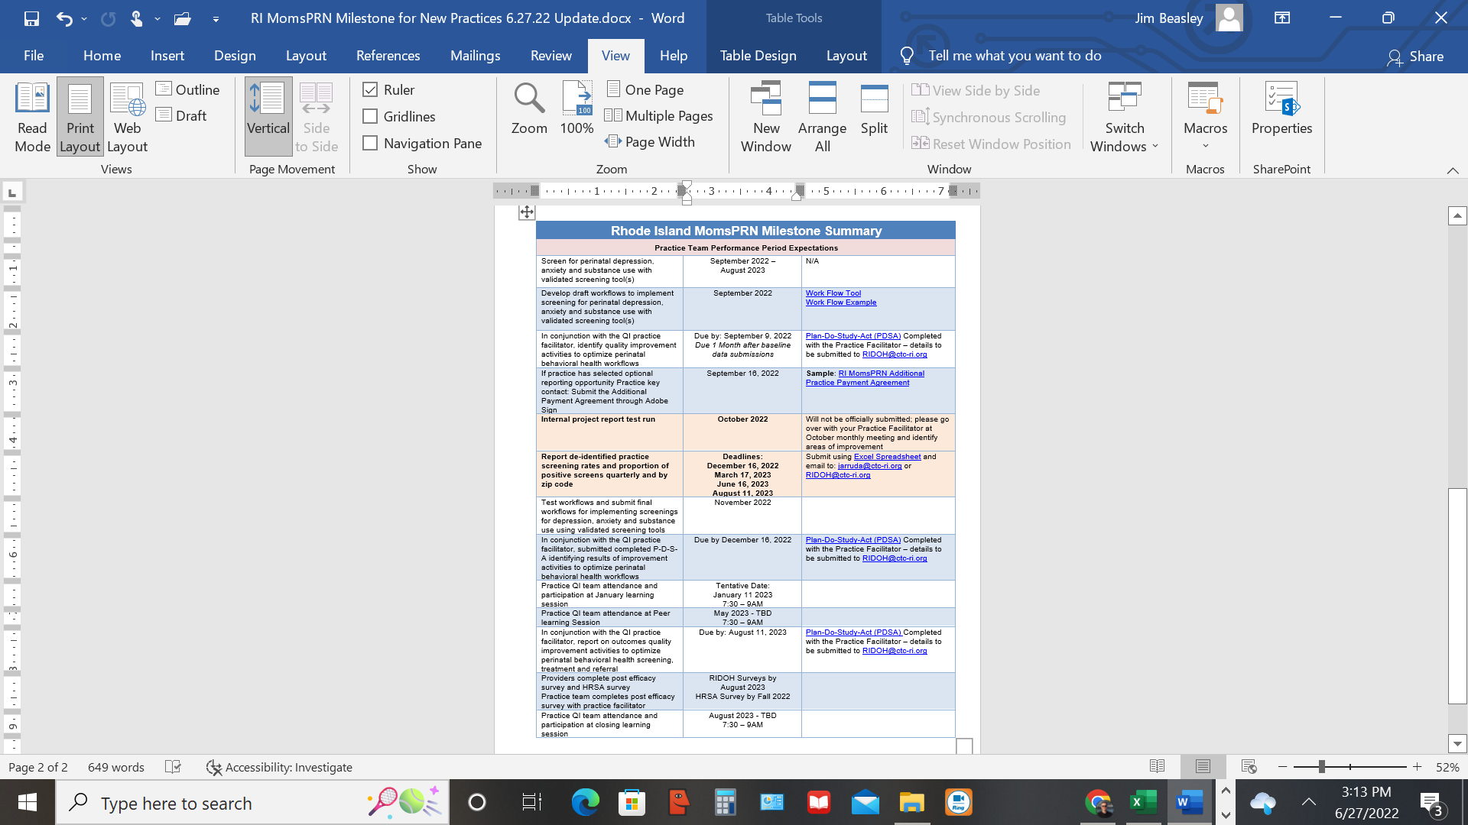
[New Practices]

Slide 37
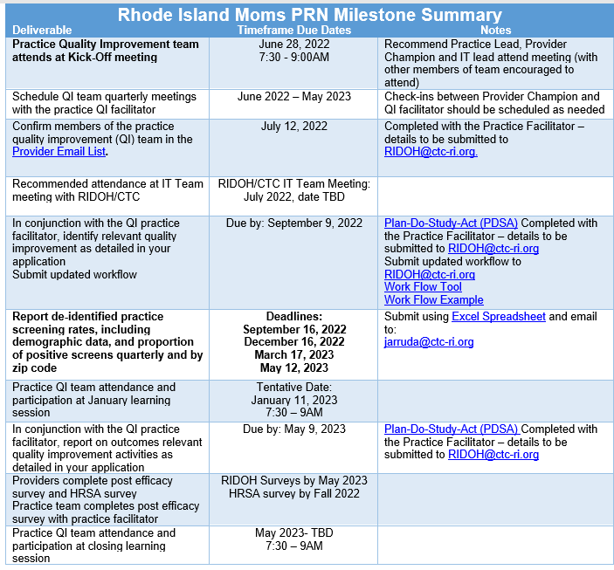
[Continuing Practices]

Slide 38
Continued vs New Participation
Shared Goals/Activities
    Learning Collaborative Sessions
    Increase screening rates for depression, anxiety, and substance use with validated screening tools
    Subject matter expert learning sessions
Continued Practices
    Report de-identified practice screening rates, including demographic data, and proportion of positive screens quarterly and by zip code
    Specialized work plans for area of improvement based on Cohort 2 outcomes
New Practices
    Report de-identified practice screening rates and proportion of positive screens quarterly and
    by zip code (optional demographic data submissions)

Slide 39
De-Identified Screening Reports
New Practices will submit baseline (9/1/21 – 7/31/22) data for each domain (anxiety, depression, and substance use disorder) of attributed perinatal patients on 8/18/22.
If no validated screening tool(s) were used and/or data is not able to be pulled electronically, practices are to report zero(s).
All Practices during performance period will report de-identified counts of attributed perinatal patients, those screened with a validated tool for each domain, those screened positive within each domain, and patient zip.
CTC-RI will provide de-duplication and reporting support/assistance.
Doodle poll for July IT / measure specification meeting will be sent out shortly
(required of new practices; recommended for continuing practices)

Slide 40
Practice & Provider Evaluation Surveys
  RIDOH (pre-* and post-^): Helps measure clinical self-efficacy improvements made over the learning collaborative
  HRSA^ (just once at Oct/Nov ‘22): Helps federal partner measure effectiveness of perinatal behavioral health supports offered by funded programs across the nation
  No identifiable information will be reported with any survey
  Providers are defined as those who clinically manage perinatal behavioral health (e.g., assess, refer, and treat). Exclude support staff just involved in one aspect (e.g., MAs)
  Seeking ≥ 80% completion rates among practice providers for full practice payment
*New Practices; ^All Practices

Slide 41
Next Steps
  Individual practice kick-off meeting with CTC practice facilitator, WIH, and RIDOH staff for both continuation and new practices
  New Practices: CTC practice facilitator will help you complete practice-level survey and discuss provider surveys and baseline data due later this summer
  Continuation Practices: CTC practice facilitator will discuss areas of focus, past submitted data, and future training needs
  Real-Time Clinical Support is Available: Call the RI MomsPRN teleconsultation line at Women & Infants Hospital Monday – Friday at 401-430-2800

