Slide 1

Overview of Community Health Teams (CHTs)
Care Transformation Collaborative of R.I.
august 9, 2018
Linda Cabral, SBIRT/CHT Project Manager

Slide 2
Overview
  Grant Overview
  Community Health Team Model
  Current Partners
  Discussion

Slide 3


Grant Overview
June 2017 – Care Transformation Collaborative of RI awarded a state grant that included braided funding from
To implement SBIRT
To implement Community Health Teams as part of SIM

Slide 4
The Community Health Team (CHT) Model – an extension of primary care
Use care management processes to address patients’
  Physical health needs
    Help accessing PCP, specialists, tests, treatments, medications
  Behavioral health needs
    Short term counseling by CHT and referral to external counseling
  Health education needs
    Medication management, nutrition, use of the health care system, appointment preparation
  Social determinants of health needs
    Help accessing: safe, affordable housing; home medical equipment; food and food banks; transportation; and completing paperwork for entitlements applications

Slide 5
Who can be served by CHTs?
Targeted patients:
  Adult patients of participating PCMHs,
  Health plan high risk lists
  In top 5% high risk/high cost/ high utilizers
  Impactable by CHT services
Goal: Improve patient care, heath, and satisfaction with care, reduce cost/unnecessary utilization

Slide 6


CHT Structure
Community Health Team
Community-Based Licensed Health Professional
(At least one)
SBIRT Screener
(At least one)
Community Health Worker (CHW)
(At least two)
Community-Based Specialty Consultants or Referrals
Refer Patients
(Pharmacy, Nutrition)
Serve Patients
Connect Patients
6
Notes:
Developing Infrastructure for Integrated Physical & Behavioral Healthcare Provision
Expand Home and Community-Based Care, increase access to specialty providers
Benefits, how taking this approach integrates behavioral and physical health and how this aligns with SIM goal.

Slide 7



Local Community Health Teams
Schools
Transportation
Environment
Community Health
Team
Outpatient Services
Workplace
Care Mgt
Health Equity Zone
Food Systems
PCMH
Practices
Specialists
Community Health
Worker
Shopping
Hospital Services
Behavioral
Health & Sub Abuse
Income
Heat
Physical Therapy
Housing
Faith Community
Literacy

Slide 8
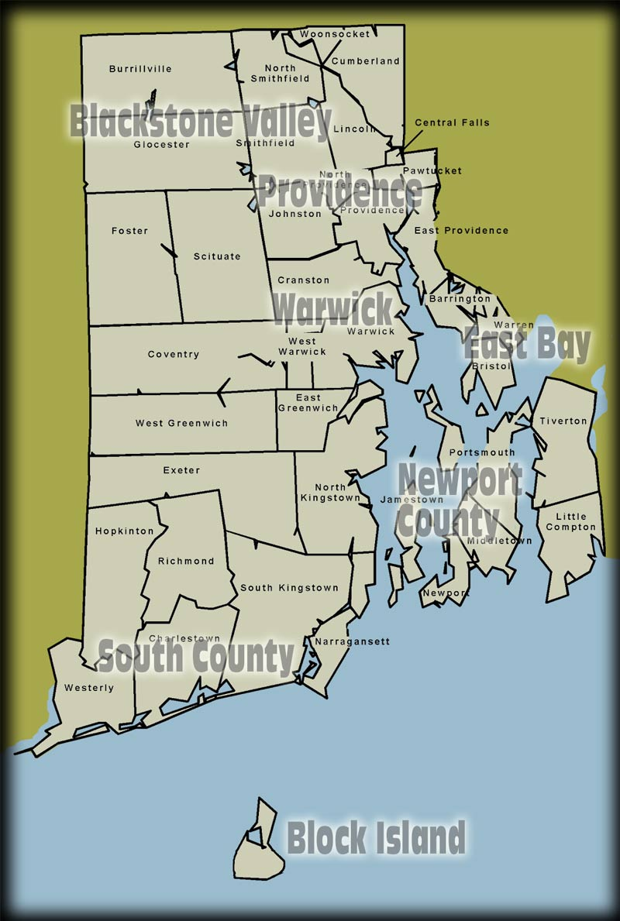
Current CHTs
Woonsocket – Thundermist Health Center
Blackstone Valley CHC
Providence – Family Service of RI
West Warwick – Thundermist Health Center
Newport – East Bay Community Action Program
Washington County – South County Health

Slide 9
CTC-RI’s Role
CTC-RI was awarded the contract to provide consolidated operations management for CHTs and SBIRT
Project Management
Direction of all CHT and SBIRT teams
Data and quality management
Collaboration with other Partners (i.e. evaluators, RIC, RIQI)

Slide 11








Implementation Partners
South County Health | Existing CHT; New role for Centralized Management for all Community Health Teams; added SBIRT screener to existing CHT
Blackstone Valley CHC | Existing CHT; added SBIRT screener to existing CHT
Thundermist | CHT serving Woonsocket and W Warwick; added SBIRT screener
Family Service of RI | New CHT serving Providence; added SBIRT screener
EBCAP | New CHT serving Newport (funded by United Healthcare); added SBIRT screener
The Providence Center | Overall SBIRT technical assistance and SBIRT implementation in participating hospital emergency departments and DOC
Rhode Island Parent Information Network, CCAP | Addition of SBIRT Screeners to existing programs

Slide 12
Grant Management
Linda Cabral | lcabral@ctc-ri.org
Liz Fortin | efortin@southcountyhealth.org
CHTs
Blackstone Valley Community Health Center | Pawtucket/Central Falls | shewitt@bvchc.org
East Bay Community Action Program | Newport | areda@ebcap.org
Family Service of Rhode Island | Providence | pechieal@familyserviceri.org
South County Health | Washington County | mpadilla@southcountyhealth.org
Thundermist Health Center | Warwick/Woonsocket | GloriaR@thundermisthealth.org
SBIRT
Comprehensive Community Action Program | Cranston, Warwick | jnorthupjones@comcap.org
Rhode Island Parent Information Network | flexible | masland@ripin.org

Slide 13
Discussion Questions
What connections do IBH practices currently have with CHTs?
What additional opportunities are there for IBH practices to collaborate with their local CHT?

Slide 14
Thank you

