Slide 1
Addressing Quality Gaps in the Midst of COVID-19 Amil Qureshi, DO MMM Medical Director PCHC August 2020

Slide 2
Immunizations
Prioritization of well visits and vaccine-related visits
Target age: ≤ 2 years of age (fairly continuous since the start of the COVID-19 pandemic)
Identification of patient population with immunization (and other) Care Gaps
Outreach: Attempts to close Care Gaps (incremental strategies in alignment with stages of re-opening)
Robust and continuous EHR data analyses
Required: symptom screens for the child and household x3 (at appointment booking; 1 day prior; time of check-in)
Required: different approach such as blended virtual/in-person visits
Notes:
At onset of pandemic, medical practices restricted direct care to essential services, while shifting most types of visits to virtual visits. This has caused significant drops in preventative services such as childhood immunizations. The national rates for “primary” vaccines (birth through age 2) have started to drop due to lack of safe access and other reasons..
PCHC also restricted face-to-face visits to essential services at the start of the pandemic. However, we deliberately built our plan around delivering care high risk groups – including pregnant women and children who needed vaccines.

Slide 3
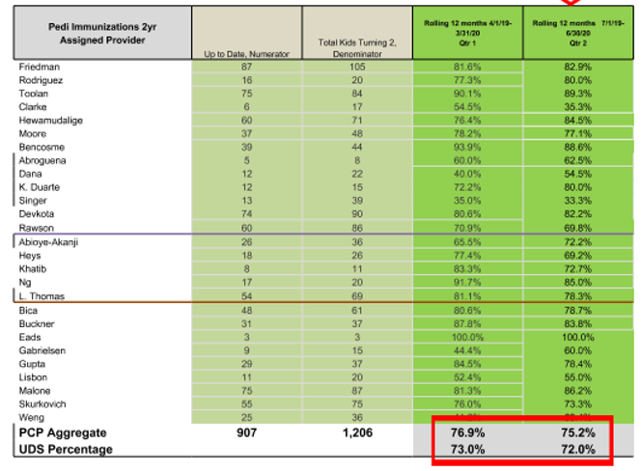
A Moment of Hope?
Notes:
Below is our data for the vaccine rates for children turning 2 years of age. The two dark green columns on the right show how each care team was doing at the end of March (a 12 month snapshot thru Q1) and June (a 12 month snapshot thru Q2). In order to pass, a child needs to receive 24 different vaccines before they turn two. The national average for FQHCs is ~40%. PCHC vaccinated 71% last year has been one of the best in the nation for many years.
Of note the data is blended with 9 months pre-Covid and 3 months of Covid
Best practices to proactively immunize children despite the pandemic

Slide 4
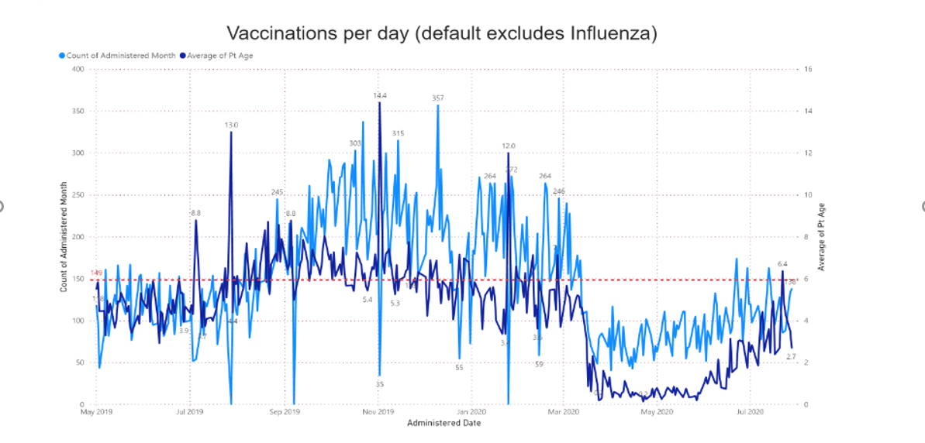
Non-influenza Vaccinations/Day by Patient Age
Notes:
This is data from Intergy through 7/28/2020.
It is all vaccinations aside from Influenza.
It shows the vaccines done per day (volume), and the average age of those patients vaccinated that day (‘who’).

Slide 5
Outreach

Slide 6
Strategies to Succeed: Using the Opportunity Outreach Report

Slide 7
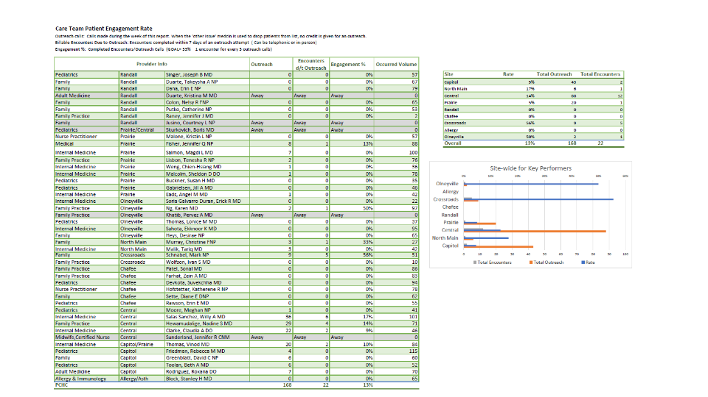
Outreach Report by Provider
Notes:
Doing outreach is a challenge for our pediatrician. They would rather have face to face visits then virtual visits. Outreach process involve an initial phone contact with patients

